Slide 1
Virginia’s Budget Outlook
Virginia Association of Counties
Fiscal Analytics, Ltd.
November 10, 2025

Slide 2

The Budget Framework
The current state of Virginia’s finances
The economic outlook
The revenue outlook
Mandatory/high priority spending needs
Policy decisions concerning discretionary spending and taxes

Slide 3
State Finances Are Sound
Approximately $2 bil. cash cushion carried into FY 2026.
  $900 million in unappropriated balances.
  $572 mil. GF revenue surplus in FY 2025 which also increases the revenue base going forward.
  $480 mil. in unexpended appropriations for FY 2025
$4.5 billion in mandatory and voluntary GF reserves in FY 2026 (14% of the GF)
Improving Virginia Retirement System finances – teacher funded status currently 87%, with the VRS proposed rate going down from 14.21% to 12.20%.
  If adopted, this would save hundreds of $millions in contributions needed by state and local government.
Significant unused debt capacity (at least $1.31 bil. per year new debt capacity available - with interest payments still less than 5% of GF).
Existing structural budget balance between expected revenues and current ongoing appropriations.
Still positive wage and salary growth, despite turbulent national policies particularly affecting Virginia.
  Better idea of the effect of federal employment cutbacks later this fall.

Slide 4
What are the Risks to Virginia’s Finances?
Economic slowdown. Federal employment reductions could increase unemployment and reduce tax revenues. While there are an estimated 300,000 federal civilian employees living in VA (7% of 4.3 mil. total VA employment), a large share are in defense-related agencies and not likely to be cut.
Artificial intelligence advances could result in productivity increases that reduce employment needs. The advent of AI is particularly impacting the market for high-skilled labor. The use of robots is also rapidly increasing.
- AI could also increase wealth and thus nonwithholding income.
Federal budget changes will pressure 1) Medicaid and SNAP programs; and 2) lost higher education and other grants; and potentially other areas of the state budget. Many changes are outside the 2026-28 biennium. Expect conservative budgeting.
Tax conformity issues from OBBBA could reduce state tax revenues.

Slide 5
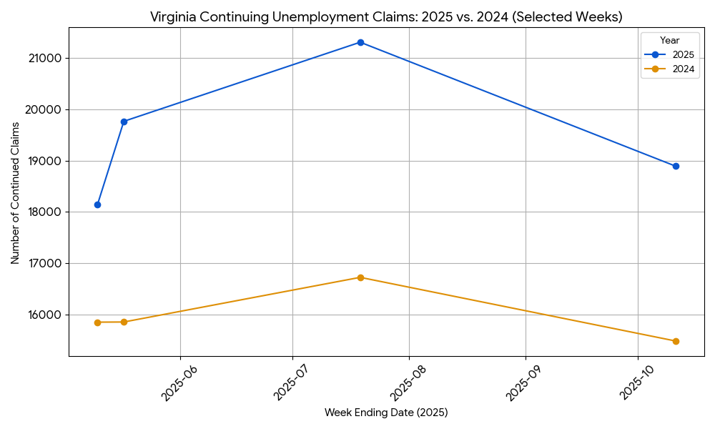
Virginia Unemployment Claims Have Risen,
But Do Not Yet Indicate a Recession
Note: 10-year average of continuing claims (excluding Covid) is 20,239.

Slide 7
The Adopted Budget Forecast Modest Economic and
GF Revenue Growth for Fiscal Year 2026 – Likely to be Higher
Source: Secretary Cummings presentation to Joint Committee, August 14, 2025.

Slide 8
Only 0.4% GF Revenue Growth
Now Needed to Meet Current Budget,
Due to FY 2025 Revenue Surplus

Slide 9
Forecast of Additional GF Resources
Available for the 2026-28 Budget
Current Economic Summary: Slowing employment growth in Virginia, but still a healthy consumer environment with little sign of credit issues; unclear level of negative impacts from federal employment decisions; lower interest rates with more accommodative Fed; strong stock market most likely indicates positive wealth effect continues for high end income taxpayers; stimulative business expensing/investment tax policies in effect, although still unclear impacts from tariff policies.
3 percent revenue growth in FY 2026, FY 2027 and FY 2028: $6-$7 bil. available, depending on unspent balances from FY 2026.
4 percent revenue growth in FY 2026, FY 2027 and FY 2028: $7-$8 bil. available, depending on unspent balances from FY 2026.

Slide 10
GF Revenue Growth
Even Higher Without Tax Reductions

Slide 12
Summary of CH. 725 Adopted Budget
Latest 2024-26 biennium budget had $4.73 bil. more GF resources than previous 2024-26 biennium budget, $3.9 bil. of which was appropriated.
  $69.5 billion in budgeted GF resources, including $3.0 bil. in transfers, and $4.5 bil. in balances.
  $62.0 bil. in estimated GF revenues ($43.7 bil. of which is individual income taxes)
  Actual FY 25 GF revenues were $572 mil. higher than forecast in the budget, mainly the result of higher nonwithholding income tax payments.
Budget assumed GF revenue growth of 4.1% in FY 2025 and 2.5% in FY 2026. Actual GF revenue growth in FY 25 was 6.1%. Now only need 0.4% GF revenue growth in FY 26 to make current budget forecast.
The enrolled budget had an unappropriated GF balance of $51.0 mil. However, the Governor vetoed approximately $849.5 mil. in spending that was included in the budget adopted by the General Assembly - leaving $900 mil. unappropriated.
  $691.3 million in capital projects spending vetoed (mostly for higher education institutions).
  $168.2 million in operating spending vetoed, with $16.9 mil. not recognized by the GA.

Slide 13
Major New One-Time
Ch. 725 2024-26 Expenditures
$977.8 mil. to fund a tax rebate
$294.5 mil. for the Revenue Reserve Fund
$175.0 mil. for the I-81 improvement project
$134.4 mil. to fund a $1,000 bonus for teachers without a local match requirement
$131.9 mil. to replace the state’s revenue collection system at the Department of Taxation
$83.1 mil. for a 1.5% bonus for state employees and state-supported local employees
$50 mil. to support the City of Richmond’s ongoing Combined Sewer Overflow project
$25 mil. for grants to localities to upgrade or replace existing drinking water infrastructure
Capital Outlay
$133.8 mil. for projects at institutions of higher education.
$226.1 mil. for state agency projects, including planning for a new state agency building at the site of the VDOT Annex and a replacement state laboratory, funding for State Police to continue planning a new Training Academy and to purchase a new Area 6 headquarters, allocations to make critical repairs to DBHDS facilities and to renovate offices in the Patrick Henry Building

Slide 14
Major New Continuing
Ch. 725 2024-26 Expenditures
Health and Human Services
$601.8 mil. for increased utilization and inflation of Medicaid
$100.3 mil. for estimated caseload and cost increases in CSA.
$88.3 mil. for the children’s health insurance programs (FAMIS and M-CHIP)
K-12 Public Education
$223 mil. to eliminate the K-12 support cap in FY 2026
$110.7 mil. to support additional English Learner students
$53 mil. for K-12 special education basic aid add-ons
Higher Education
$75 mil. to maintain affordability and access goals at public colleges and universities
$26.8 mil. in additional financial aid support
Natural and Historic Resources
$26.3 mil. for WQIF agriculture best management practices
$17.4 mil. to support reimbursements for projects identified as part of the Enhanced Nutrient Removal Certainty program
Other
$40.5 mil. to support a 6.0% increase in premiums for the state employee health insurance program

Slide 17
Mandatory/High Priority Budget Drivers for the 2026-28 Biennium Budget
$974 mil. K-12 education rebenchmarking for 2026-28, not including a new ADM and sales tax forecast.
Medicaid utilization and inflation with much higher managed care rates (new forecast is $410 mil. in FY 26 and $2.8 bil. in 2026-28 biennium).
  Most OBBBA Medicaid savings will accrue to lower federal funding of the expansion population, not state GF.
Children’s Services Act (CSA) cost increases ($180 mil.)
SNAP administration costs are currently shared 50% state/50% federal (with a local match of 15.5% on the state match). The OBBA changed the state admin match rate to 75% on Oct. 2026. This will cost the state an additional $65 mil. in FY 2027 and $90 mil. thereafter, with a possible additional local match.
Unless the state reduces its current SNAP error rate of 11.5% to under 6% then the state will be on the hook for $211 mil. in FY 28 and up to $270 mil. in future years.
Higher H&HS provider rates – such as mental health and DD waiver services rates
Salary increases for teachers and state employees @ 3% each year = $600 mil.)
Conforming to federal AGI tax changes ($1.1 bil., incl. FY 2026)

Slide 18
Discretionary Budget Possibilities for the 2026-28 Biennium
Remaining JLARC K-12 recommendations
  Already funded the support cap removal and at-risk student recommendations.
  Remaining unfunded recommendations include: unfunded staffing such as teacher assistants and assistant principals, inaccurate prevailing salary methodology, small schools economies of scale adjustment, more accurate cost-of-living adjustments, and rebenchmarking that covers real-time costs.
VDSS costs related to SNAP quality control, such as the IT system that manages benefits, which would also help with Medicaid redeterminations as well.
Constitutional officer staffing needs per workload-based staffing standards.
Economic development projects, such as business-ready development sites
Higher Education funding requests
Capital outlay including vetoed projects
Wastewater treatment and BMP upgrade costs beyond WQIF funding levels
Correctional officer salary increases
Federal tax change costs that do not normally flow thru to Virginia
Backfilling reduced federal policy changes and grants – such as K-12 cuts

Slide 19
Major Medicaid Provisions in OBBBA
Major Provisions | Local Impact | State GF Impact
Community Engagement Requirement (80 hours a month) for Able-Bodied Adults (verified at initial enrollment and each renewal) – effective December 31, 2026 | Yes | Yes
Cost Sharing for Expansion Members >100.0% of the Federal Poverty Level – effective October 1, 2028 | No | Yes
Modifies Retroactive Coverage from Three Months to One Month Prior to Application for Medicaid under Expansion and two months for all other – effective January 1, 2027 | Yes | Yes
Eligibility Determination for Expansion Members Must be Redetermined Every Six Months, verification of duplicate enrollment and deceased individuals – effective January 1, 2027, and January 1, 2028 | Yes | Yes
Narrows the definition of qualified alien; Payments for services under Emergency Medicaid limited to 50 federal match rate if non-citizen under Expansion – effective October 1, 2026 | Maybe | Yes
Payment reduction related to certain erroneous excess payments under Medicaid – effective October 1, 2029 | Yes | Yes
Source: Mike Tweedy, Senate Finance and Appropriations Committee. For additional info see:
https://sfac.virginia.gov/pdf/Jt%20Sub%20HHR%20Oversight/2025/No3_Cheryl%20Roberts,%20DMAS%20Presentation.pdf

Slide 20
Supplemental Nutrition Assistance Program (SNAP) Changes in OBBBA
Provisions | Local Impact | State GF Impact
State match requirement for SNAP benefits (minimum of 0.0 percent up to 15.0 percent based on the state's payment error rate – effective October 1, 2027 | Yes, pressure to reduce error rates | $90 - $270 million GF a year
Administrative cost sharing increased from 50.0 to 75.0 percent for states - effective October 1, 2026 | Yes, local share | $80 - $90 million GF a year
Limits adjustments to the Thirty Food Plan to annual inflation adjustments – effective July 4, 2025 | No | No
Increases the age from 54 to 64 that Able Bodied Adults without Dependents must work to receive SNAP (dependent child is changed to be under the age of 14 and not 18) | Yes | Yes
Restricts use of LIHEAP payments of $20 or more to automatically qualify for the standard utility allowance in determining SNAP benefit amounts to households with elderly or disabled members and prohibits the use of household internet costs from being used in computing the excess shelter expense deduction for SNAP benefits – effective July 4, 2025 | Yes, adds complexity | No
Limits SNAP benefits to individuals who reside in the United States and are 1) citizens or lawful permanent residents; 2) immigrants who have been lawfully admitted for permanent residence; 3) immigrants who have been granted the status of Cuban or Haitian entrant; or 4) individuals who are lawfully residing in the country in accordance with the Compacts of Free Association between the United States and Micronesia, the Marshall Islands, and Palau. | Maybe, for verification purposes | No
Source: Mike Tweedy, Senate Finance and Appropriations Committee

Slide 21
The Fiscal Health of Hospitals Will Be in Question over the Next Few Years
The new federal law requires Virginia to lower its 6% hospital provider tax by half a percentage point each year starting in October 2027 until it hits 3.5% in 2032.
  Reduced hospital Medicaid payments will also reduce provider tax amounts.
  The hospital provider tax currently generates $1 billion a year that the state combines with federal dollars to make supplemental Medicaid payments to hospitals.
  New $50 billion federal Rural Health Transformation Fund could provide some assistance to rural hospitals in VA (up to $1 bil. to VA over 5 years).
The OBBBA didn’t extend the enhanced Affordable Care Act insurance premium tax credits for health insurance, which will drive up insurance costs for the low and middle income.

Slide 22
Timeline of Key Health Policy Provisions
FY 2026
Rural Health Transformation Disbursements Begin
Initiative begins to improve SNAP error rates
FY 2027
Begin increased SNAP administrative costs (3/4 of year)
Enhance Medicaid eligibility determination workforce
Begin complying with Medicaid Community Engagement Requirements (80 hours a month) for Able-Bodied Adults
FY 2028
SNAP error rate state costs begin
Begin reduction of 6% provider taxes for state directed payments to hospitals in October 2027

Slide 23
Virginia Tax Conformity to OBBBA
Could Reduce Revenues, if Adopted
Virginia has static (fixed date) conformity to federal tax changes (IRC), where the incorporation of changes has to await the legislature’s decision to manually update any IRC conformity. Conforming to individual provisions would cost $56.6 mil. from FY 26 thru FY 28. Business provision changes would cost $1.1 bil. and include 4 significant changes to business expensing:
  The full expensing provision for machinery, equipment, and certain other tangible property is restored and made permanent;
  restoring immediate cost recovery for research and development costs;
  new first-year expensing for qualified production property (e.g., factories);
  The cap on the § 179 expensing deduction for small businesses is raised from $1 million to $2.5 million.
Examples of OBBBA personal tax issues that would not flow to Virginia by updating conformity, but could be considered include:
  $668 mil. - Deduct a portion of overtime for both itemizers and non-itemizers for tax years 2025-2028, with some exclusions, such as for highly compensated employees.
  $210 mil. - Exempt certain qualified tips from income taxation for tax years 2025-2028, structured as a deduction available to itemizers and non-itemizers alike.
  $185 mil. - Deduct personal passenger vehicle loan interest up to $10,000 per year, with a phaseout for high earners beginning at $100,000/$200,000 for joint filers in income.
  $136 mil. - Charitable deduction for nonitemizers

Slide 24
New Revenues From Potential Tax Policy Changes
$800 mil. - $1 billion per year by applying sales tax to “new economy” purchases
  The 2024 General Assembly’s original enrolled budget bill (not ultimately agreed to by the Governor) applied sales tax to purchases such as digital services or electronic products in five distinct categories: 1) software application services including business-to-business; 2) computer-related services; 3) website hosting and design; 4) data storage; and 5) streaming services
$500 million per year by adding 2 new top income tax brackets
  Add a new 6% tax bracket from $100,000 to $1 million and a second new 6.75% bracket for income above $1 million.
In the latest JLARC report (1/22/25) comparing Virginia to other states, Virginia was ninth lowest among the 50 states for the percentage of state and local revenue as a percentage of personal income at 18.5%.

Slide 25
Virginia Tax Competitiveness
Versus Surrounding States

Slide 27
Virginia Has a Lower Sales Tax Rate and Service Base than Surrounding States
Source: https://www.finance.virginia.gov/media/governorvirginiagov/secretary-of-finance/pdf/12_23Presentation-(with-Appendix).pdf

Slide 28
Sales Tax on “New Economy” Products in Surrounding States

Slide 30
Recent GF Tax Reductions in Virginia

Slide 31
Appendices

Slide 33
Virginia General Fund Revenue Sources

Slide 34
Non-General Funds are Dedicated for Specific Uses

Slide 35
Virginia’s Federal Expenditures​ Have Grown Substantially
Source: Mike Tweedy, Senate Finance and Appropriations Committee

