Slide 1
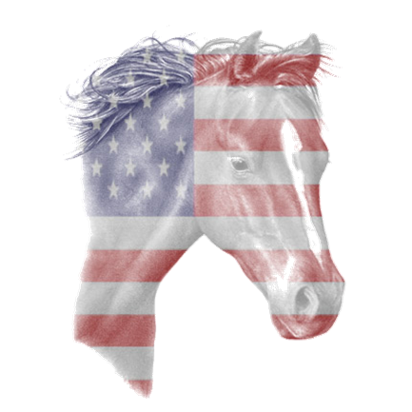

Inaugural Liberty Ride
September 22, 2012
2013 VACo Achievement Award Submission
Supplemental PowerPoint Presentation
Category: Parks & Recreation
Nominee: Orange County Parks & Recreation

Slide 2
Statistics &
Survey Results
11 Miles Round-Trip
66 Participants, 70 Horses
41 Out of County Participants
25 In County Participants
$1,487.94 Raised for OCPR Foundation
*0% responded as “unsatisfied,” “completely unsatisfied,” or
“unfavorably,” in any survey question!

Slide 3
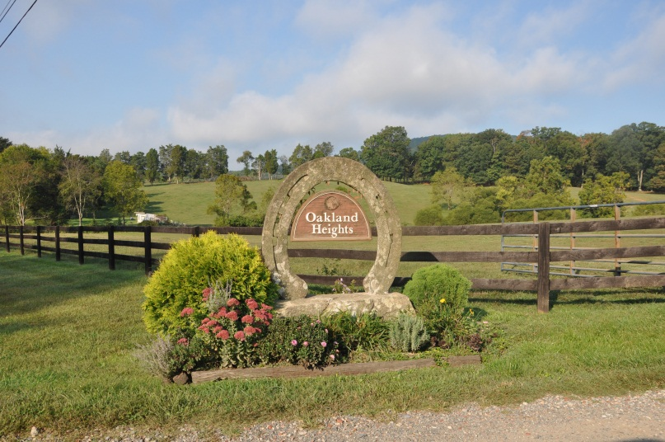
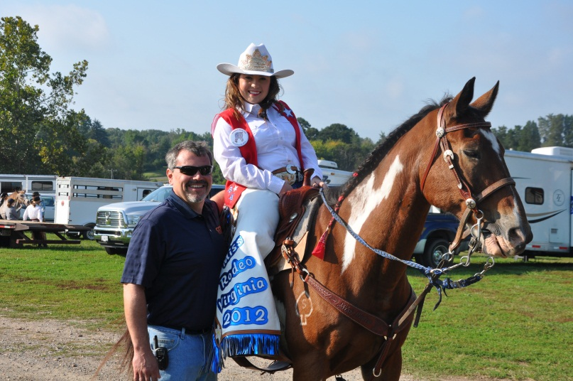
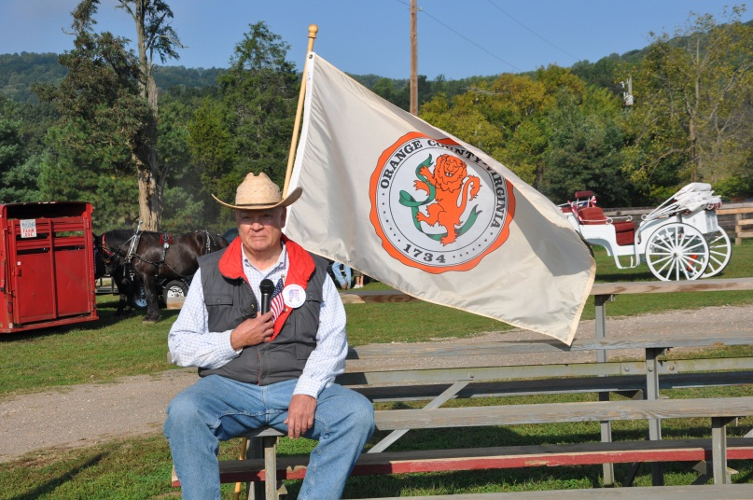
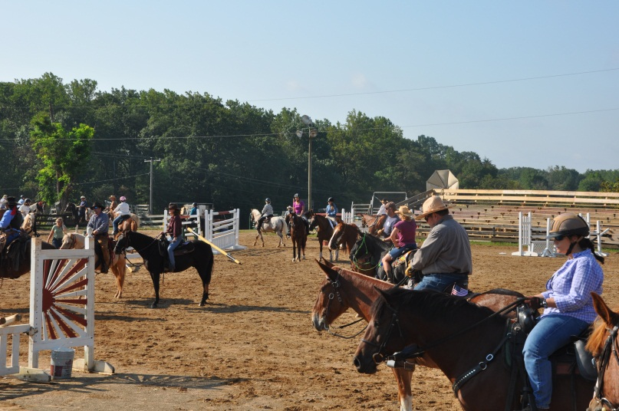
Take a Ride…
Getting Started…

Slide 4
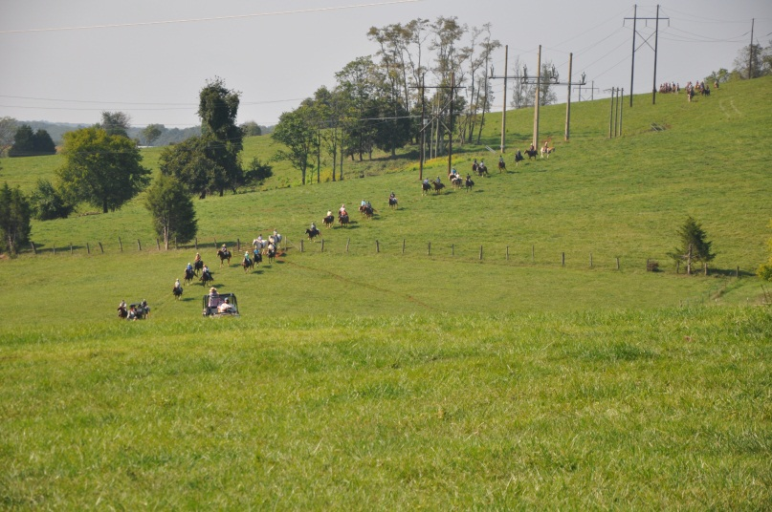
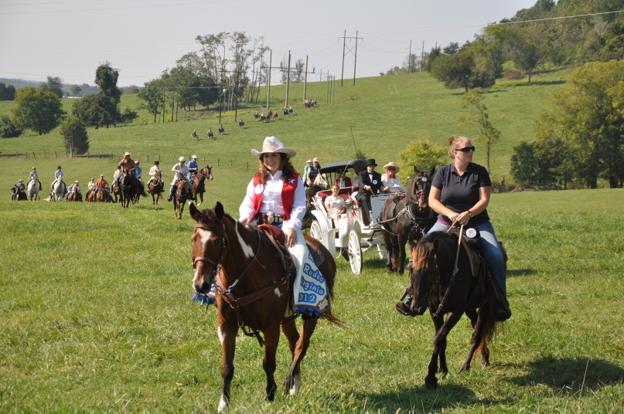
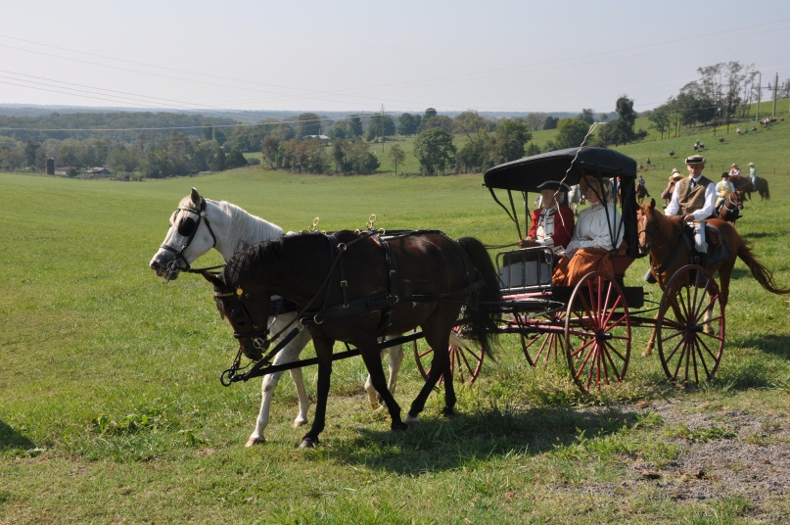
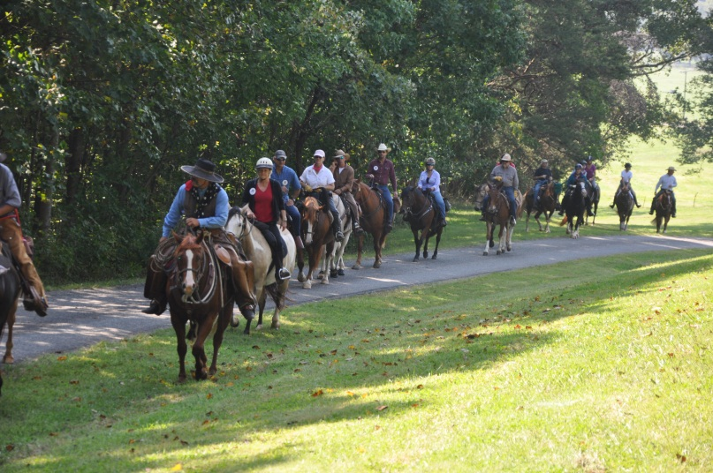
Take a Ride…
Underway…

Slide 5
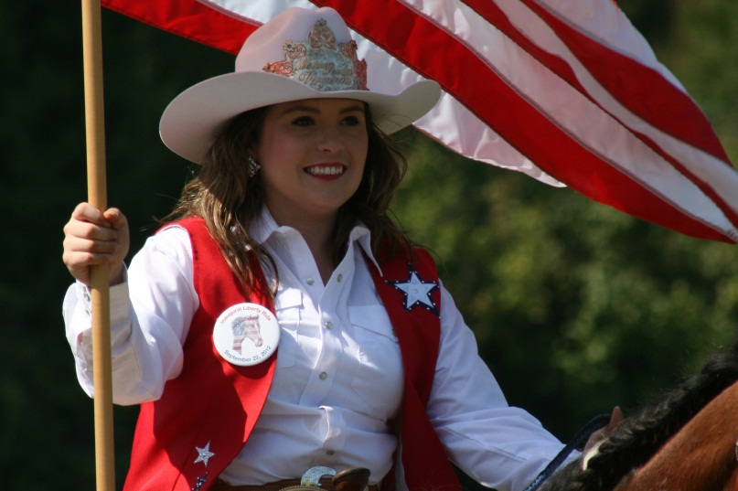
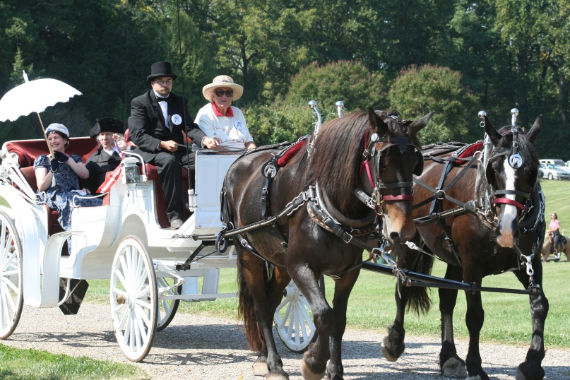
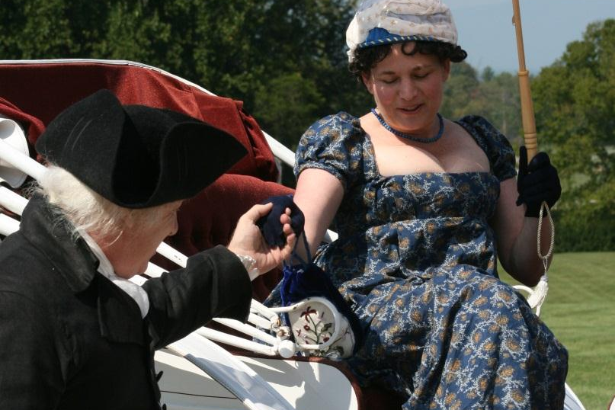
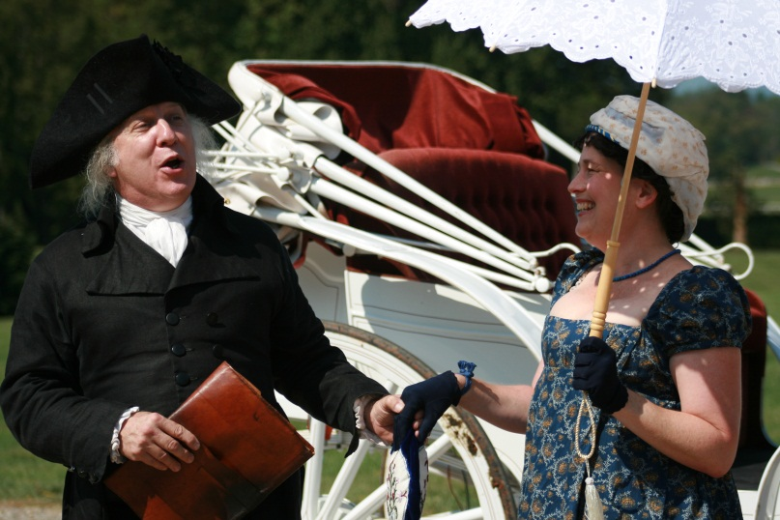
Take a Ride…
*These photos courtesy of The Orange Review
Arrival at Montpelier…

Slide 6
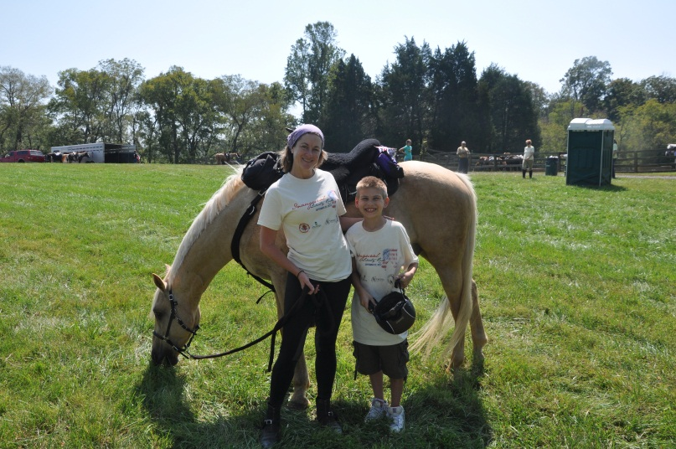
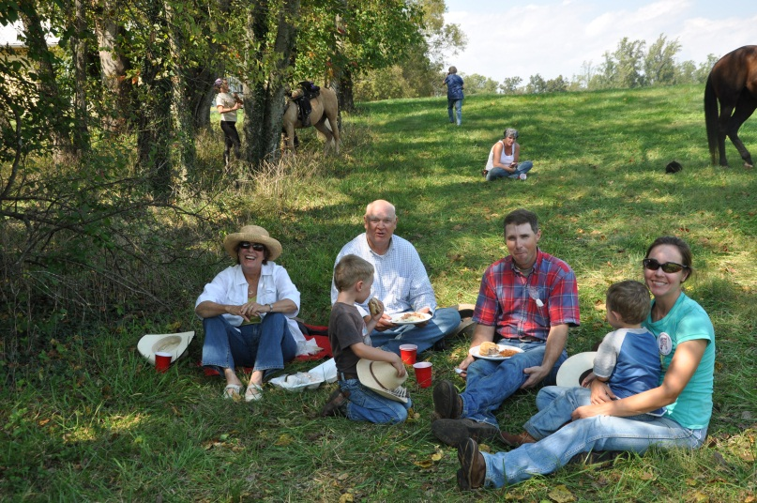
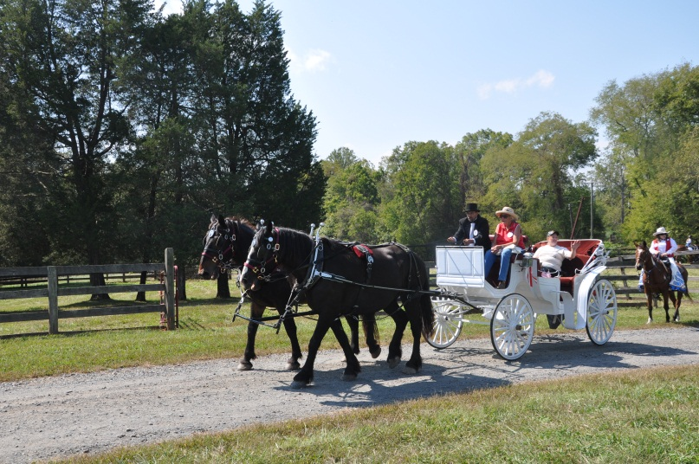
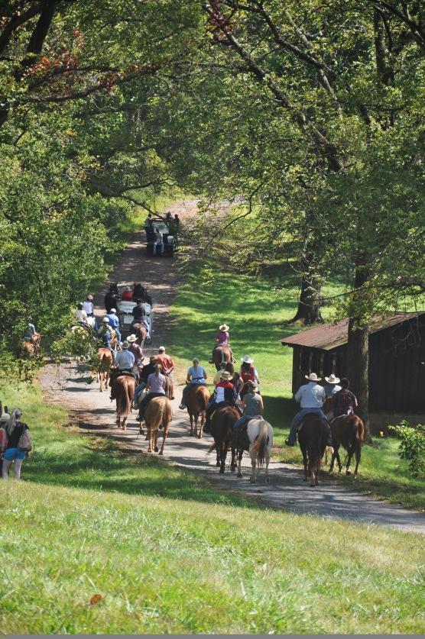
Take a Ride…
Taking a Break… then Heading for Home…

Slide 7
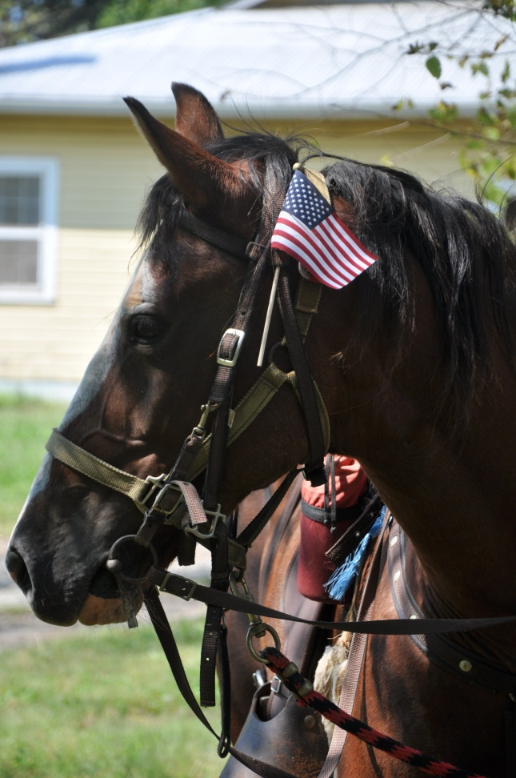
The 2012 Liberty Ride
Happy Trails…

