Slide 1
Keeping in Touch
Public Relations in Fairfax County
and the Hunter Mill District

Slide 2
Voice of Fairfax County
Office of Public Affairs
  Daily Newswire
  County webpage
  Social media
Channel 16
Emergency information
  Community Emergency Alert Network (CEAN)

Slide 3

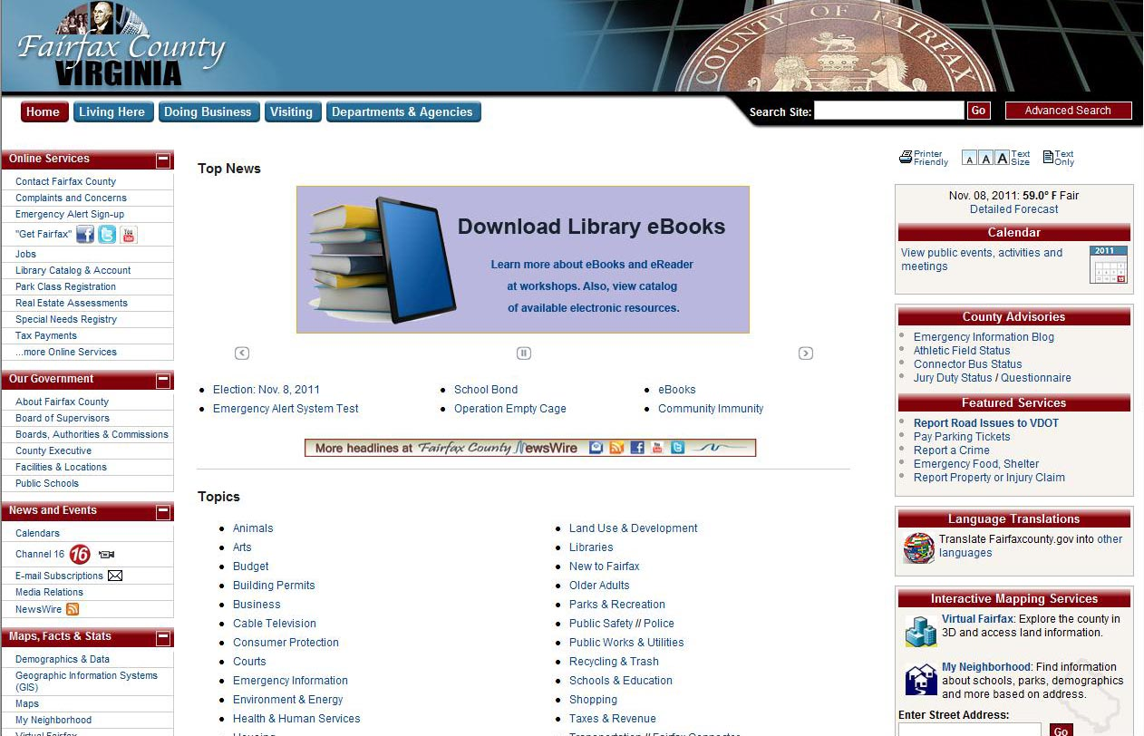


Fairfax County Communications

Slide 4
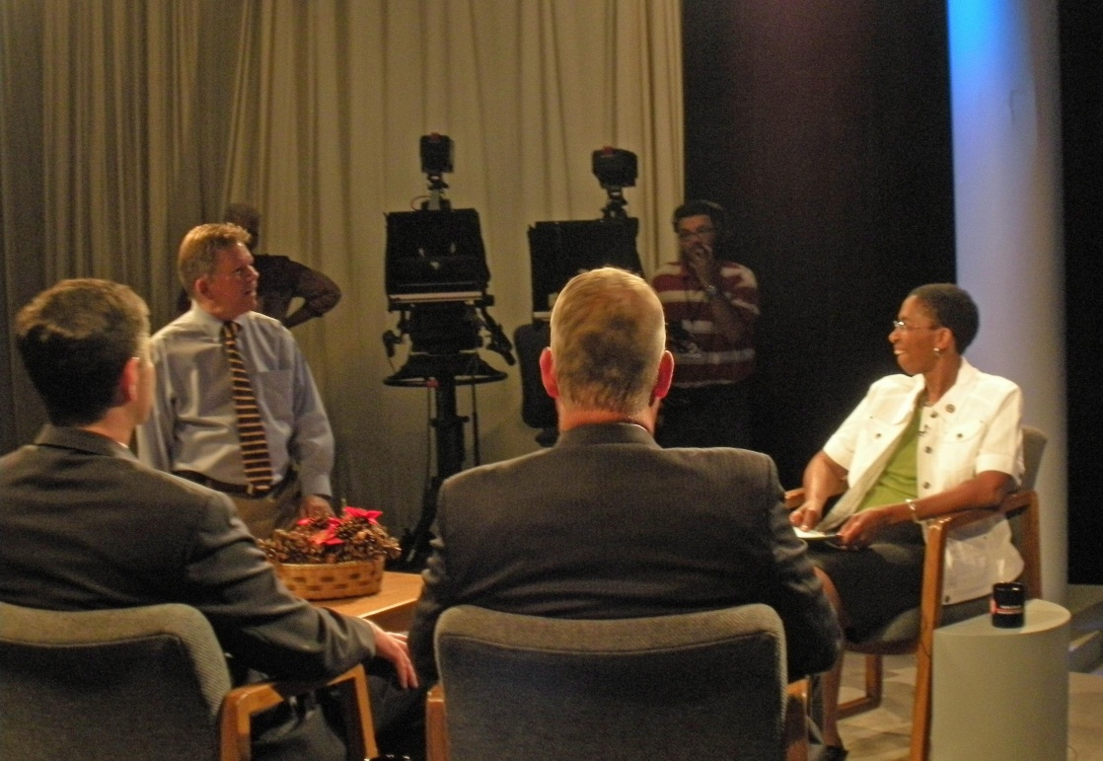
Channel
  Board of Supervisors meetings
    Broadcast live and on-demand
  Planning Commission meetings
  Supervisors’ shows
    “Connecting with Supervisor Hudgins”

Slide 5

Emergency
CEAN - application to send emergency alerts
  Cellphone
  Pager
  PDA
  Email account
Types of alerts
  Severe weather warning
  Emergency evacuation routes
  Emergency shelter info
Stay Informed
Weather
Roads
Mobile/Apps/Texts
Phone Numbers
Facebook
Twitter
YouTube
Flickr

Slide 6
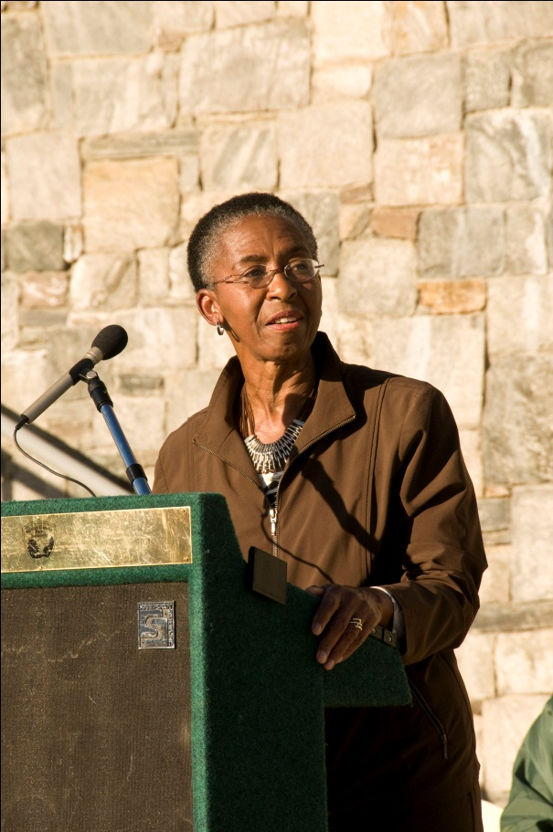
Voice of Hunter Mill District
Newsletters
Press - written and electronic
Webpage
Video
Social Media

Slide 7
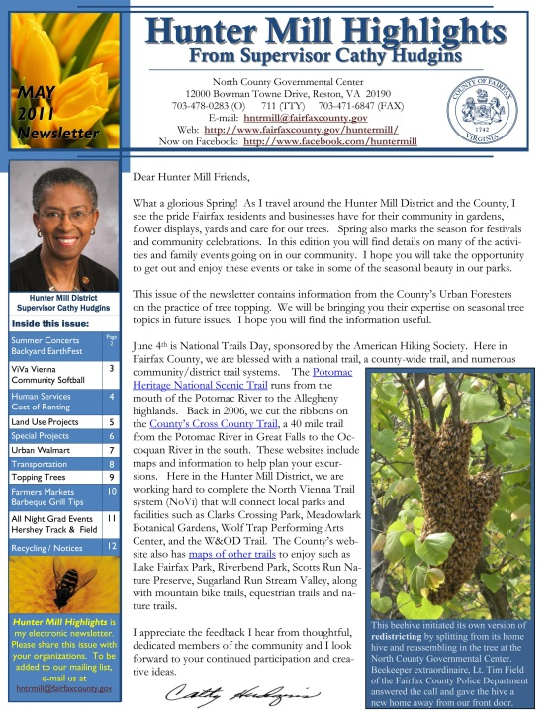
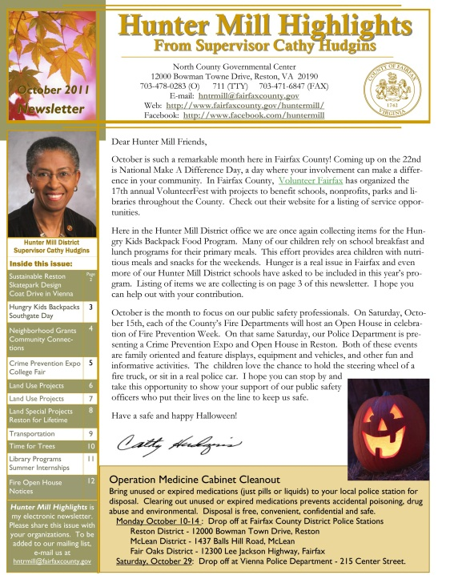
Hunter Mill Highlights Newsletter
Monthly electronic newsletter
  County programs
  Community events
  Citizen recognitions
  My voice on issues
eBlast
  Summary of BOS meetings
  Distributed to 5,600 addresses

Slide 8
5,600 addresses??
All contacts automatically go on the mailing list
Unsubscribe option
  ask to be removed
Longevity – stay in office

Slide 9
Newsletter production
  Expensive software not necessary
  Publisher – standard on MS Office Suite
Camera - digital camera to cover events
  Free on-line photos and artwork
Mailing includes the link to new issue of newsletter on Hunter Mill District webpage
  Large file is not filling up e-mail boxes
  Free to use photos, colors and graphics

Slide 10




Press
Press releases from Hunter Mill office
  Fairfax County papers
  Local/neighborhood papers
  Local electronic news blogs
  Other newsletters

Slide 11
Hunter Mill District webpage
Features
Announcements
  Upcoming events and programs
  Emergency updates for the district
Current issues, press releases
Links to newsletters, cable show, Facebook
District directory
  Parks and rec centers/libraries/schools
  Appointees
  Elected officials (U.S. & VA)

Slide 12
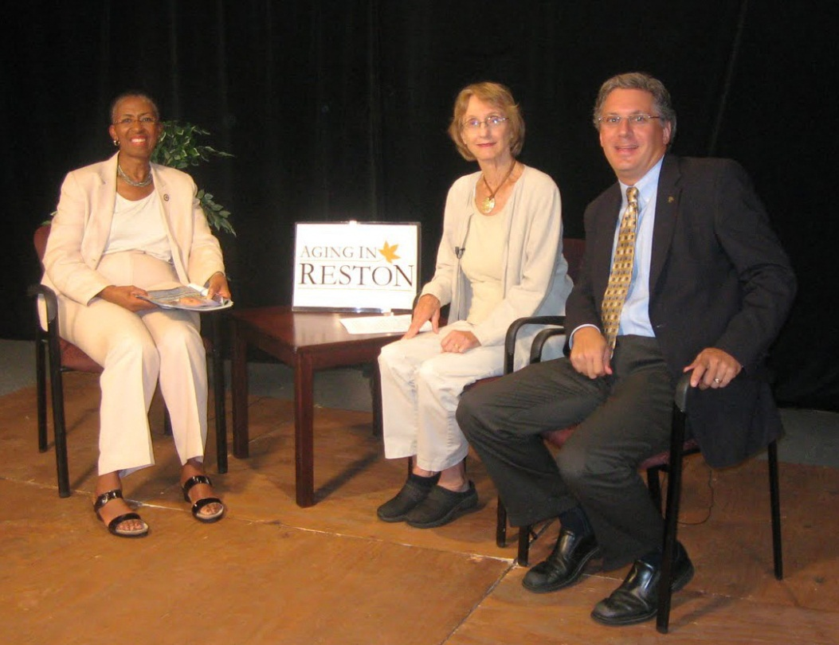
On the airwaves
Connecting with Supervisor Hudgins” cable show
  Current topics of interest to district/County
  30 minute show broadcast 3x week
  Filmed at
    Fairfax’s Channel 16
    Public access stations
  Past shows on
  Aging in Place
  Safe Routes to School
  Dulles Rail Project
  Affordable Housing Options
  Frying Pan Farm Park Celebration

Slide 13
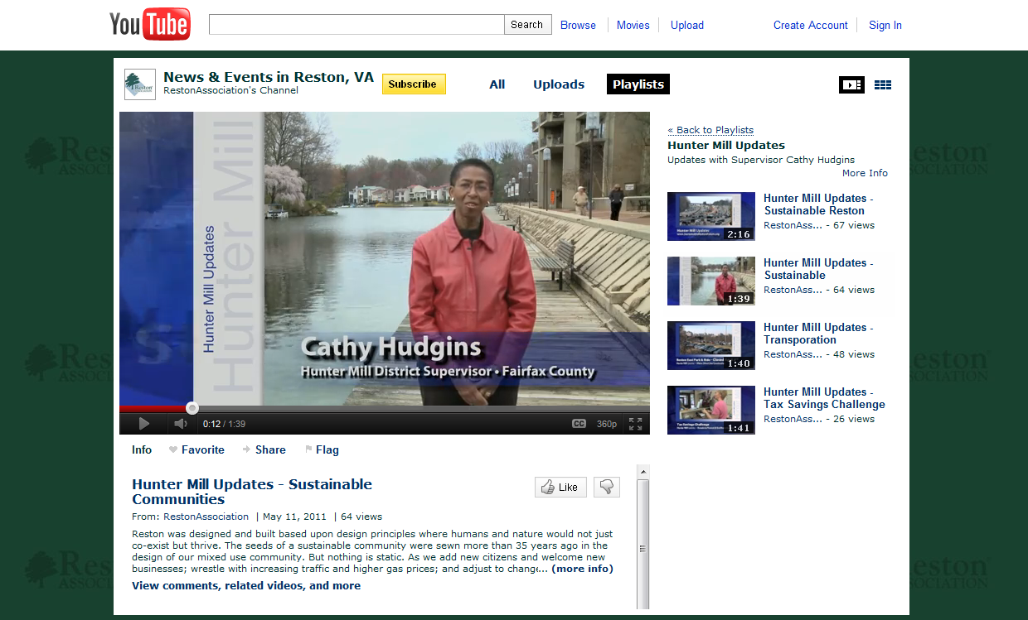
Videos
YouTube shorts
  2-5 minute shorts
  Posted on Facebook page & websites
  Filmed at
    Public Access station (Comcast & Cox)
    Reston Association studio
    High School studio

Slide 14
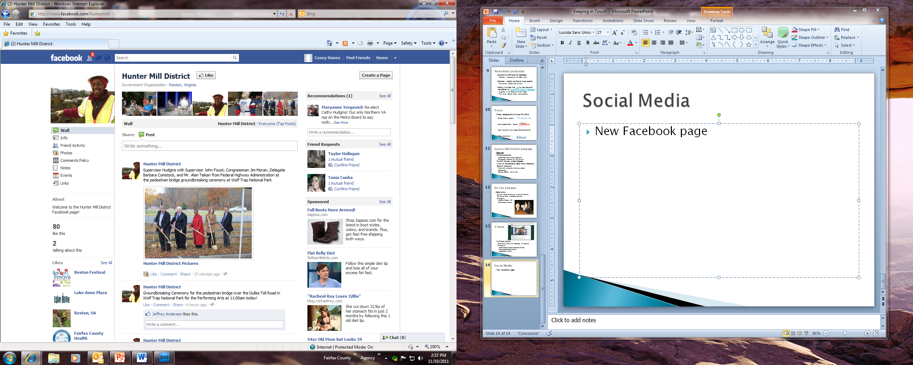
Social Media
New District Facebook page
Coming soon
  Tweets

Slide 15
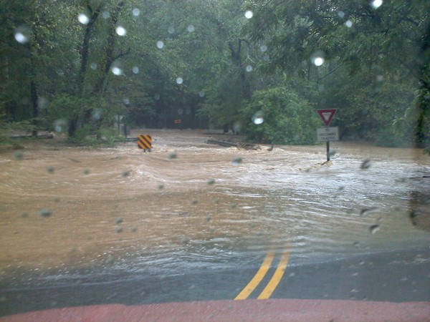
How does it all work?
Example: September Floods
  Bridge on major connecting road washed out
  Closed right before afternoon rush hour
  Sent eBlast and Facebook message to our subscribers
    Notice received before official VDOT announcement or news release
    Commuters diverted to
    alternative routes
    Accolades for timely notice
Photo from Vienna Patch

