Slide 1
Virginia’s Economy and
Budget Outlook
A briefing for the
Virginia Association of Counties
Richard D. Brown
Secretary of Finance
November 14, 2011

Slide 2
Topics for Discussion
Fiscal Year 2011 Performance and Surplus
  National and Virginia Economic Indicators
  Wall Street and Virginia’s Negative Credit Watch
  Looking Ahead: Virginia Budgetary and Funding Issues

Slide 3
Fiscal Year 2011 Revenues and Transfers Finished $310.7 Million (2.1 Percent) Above Forecast…
Summary of Fiscal Year 2011 Revenue Collections
(millions of dollars)
Total revenues increased for the first time since fiscal year 2008.
  Total revenues are still below fiscal year 2007 levels.

Slide 5
$544.8 Million FY2011
Budget Surplus
Surplus Defined: Actual Revenues above Forecasted Revenues + (Agency Savings + Agency Balances)
$544.8 Million = $310.7 Million + $234.1 Million
Total general fund revenue collections rose 5.8 percent, ahead of the revised annual forecast of 3.5 percent growth.
Revenue sources of FY2011 surplus originated from volatile sources such as non-withholding personal income tax and corporate income tax.
Surplus committed by Virginia Constitution, Code and Appropriation Act.

Slide 6
Uses of Surplus

Slide 7
Both the U.S. and Virginia Economies Performed Near Expectations in Fiscal Year 2011
As measured on a fiscal year basis (July through June), estimated real GDP increased 2.6 percent.
  Rising inventories supported growth, offsetting modest consumer spending in the face of employment losses and shrinking incomes.
In Virginia, employment gains were slightly better than expected, thanks in part to gains in the high-paying professional and business services sector. Income growth also exceeded expectations.
Summary of Key U.S. and Virginia Economic Indicators
Percent Change Over the Prior Fiscal Year
* FY11 Actual is based on three quarters of actual data and one quarter of forecast data.

Slide 8
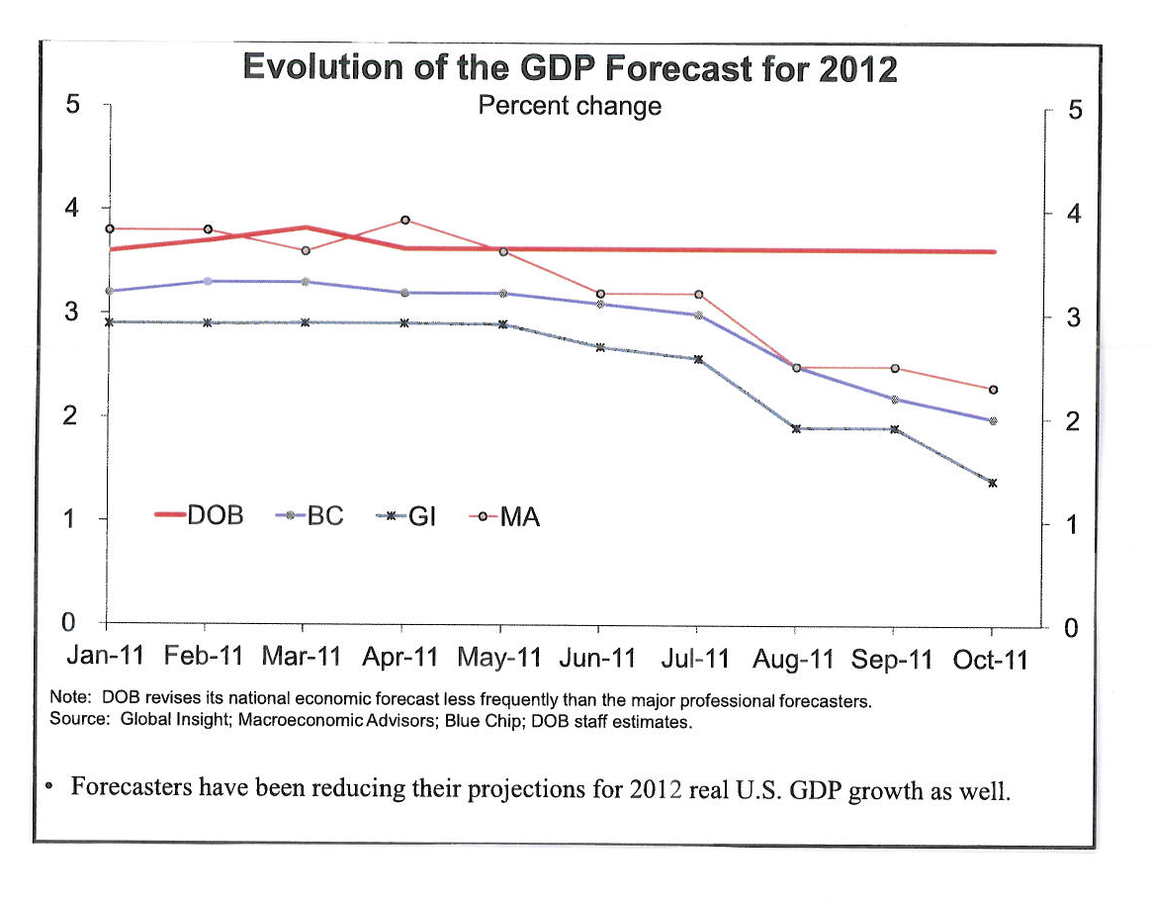

Slide 9
National and State Economic Indicators
Current national indicators continue to depict a weak recovery with a dark outlook. National GDP is expected to grow just 1% in Q4 of 2011 and 1.1% in Q1 of 2012 (on an annualized basis).
According to Global Insight and Moody’s Analytics, the two major national economists, the likelihood of the U.S. entering into a double-dip recession remains high at 40%.
The Federal Reserve has already injected its primary stimulus into the economy.
The Conference Board’s index of consumer confidence, fell to 39.8 in October, the lowest level since the 2008-2009 recession.
Job growth in Virginia has recently slowed significantly, with a recent upward trend in unemployment from 6.0% to 6.5%.
According to the Virginia Association of Realtors, for Q2 2011 compared to the prior year, the median sales price declined 2% and the total number of foreclosures increased 7.5%.

Slide 10
Virginia’s AAA Bond Rating at Risk
August 2nd
Congress raises U.S. Statutory Debt Limit with triggers
Moody’s confirms U.S. Aaa rating, but changes U.S. outlook to negative
Fitch takes no action, but announces review of U.S. to conclude by end of August
August 8th
Standard & Poor’s places VHDA’s Commonwealth Mortgage Bonds’ AAA rating on Negative Credit Watch because of their “direct link” as being insured by the FHA, an agency of the Federal Government, which was downgraded to AA+
July 13th
Moody’s places U.S. on review for possible Aaa downgrade
August 4th
Moody’s confirms Aaa rating of Virginia, but changes Virginia’s outlook to negative
July 19th
Moody’s Places Five Aaa States (including VA) on review for downgrade
August 5th
Standard & Poor’s lowers sovereign rating of the U.S. from AAA to AA+ and changes outlook to negative
August 16th
Fitch confirms U.S. AAA rating with a stable outlook
July | August
Note: It is anticipated that Moody’s will conclude its review of Virginia and determine whether our outlook remains negative or returns to stable by the end of November.

Slide 11
Strategy for Addressing Bond Ratings (Future Borrowings)
#1 - Enhance Liquidity:
  Revenue Stabilization Fund (RSF) will grow to $440 million by end of FY2013 and could double in size, $600 million by end of FY2014 with continued revenue growth. The RSF can only be used to offset a shortfall in revenue from what is anticipated in an emailed budget.
  Create Federal Action Contingency Fund (FACT) is a cash reserve that can be used to offset a variety of negative impacts on Virginia related to future federal actions which cannot be addressed by RSF.
    Replace certain losses in direct federal grants,
    Use for incentives to retain or consolidate federal facilities in Virginia. Like BRAC approach.
    Address federal tax policy changes from conformity,
    Help businesses impacted by federal procurement or defense contracts as they change to other customers
#2 – Diversify Economy
  Long-range strategy given immediate attention.
  Executive order to direct economic development personnel to fully develop strategy.

Slide 12
Fiscal Year 2012 Total Revenue Growth Needs To Be 3.7 Percent To Achieve The Chapter 890 Budget Estimate
Summary of General Fund Revenue Collections FY2011 and FY2012
(millions of dollars)

Slide 13
How Are We Doing?
General Fund Revenue Collections - October 2011
$ in Millions
 |  |  |  |  |  | Year-to-date
 |  | FY2012 Estimate |  | % Change October Collections |  | FY2012 |  | FY2011 |  | % Change |  | FY2012 Official Estimate
Individual Income Tax:
 | Withholding | $ 9,958.0 |  | +5.3% |  | $ 3,118.8 |  | $ 2,989.1 |  | +4.3% |  | +3.4%
 | Nonwithholding | 2,223.6 |  | +5.0% |  | 410.9 |  | 352.9 |  | +16.5% |  | +2.1%
 | (Refunds) | (1,852.0) |  | -5.3% |  | (163.5) |  | (184.1) |  | -11.2% |  | -0.9%
 | Net Individual Income Tax | $10,329.6 |  | +6.1% |  | $ 3,366.2 |  | $ 3,157.9 |  | +6.6% |  | +3.9%
Sales and Use Tax |  | $ 3,115.5 |  | +2.9% |  | $ 881.1 |  | $ 831.2 |  | 6.0% |  | 3.4%
Corporate Income |  | 831.6 |  | -55.1% |  | 208.9 |  | 216.8 |  | -3.7% |  | 1.1%
Wills, Suits, Deeds, Contracts |  | 301.1 |  | +0.9% |  | 104.5 |  | 101.1 |  | +3.4% |  | +3.3%
Insurance Premiums |  | 289.6 |  | 0 |  | - |  | - |  | 0 |  | +2.9%
Interest Income |  | 103.6 |  | -223.4% |  | 26.5 |  | 24.8 |  | +6.8% |  | +27.7%
All Other |  | 623.8 |  | +12.5% |  | 135.4 |  | 131.0 |  | +3.4% |  | +2.8%
Total |  | $15,594.8 |  | +3.1% |  | $ 4,722.6 |  | $ 4,462.8 |  | +5.8% |  | +3.7%

Slide 14
Final Thoughts on Revenue Outlook
Over half of the FY 2011 surplus revenue came from extra nonwithholding and corporate income tax receipts, which are more difficult to predict going forward.
National projections of economic activity appear to be deteriorating, especially in short-run (remaining half of calendar 2011), from where we were during the last legislative session.
Coming off the higher revenue base of FY2011 (surplus), we can grow 40% less in F2012 or +3.7% than originally forecast +6.0% and meet the budget revenue estimate.
Economic result is conflicting patterns to analyze.
Upside Downside
Pent- up demand Anemic job growth
Low inflation/borrowing costs Lack of consumer demand
Liquidity in system (corporate cash) Prolonged real estate slide
The game appears to be ahead of us, not so much this year!

Slide 15
Looking Ahead: Virginia Budgetary and Funding Issues

Slide 16
Base Budget Issue
Structural Balance Going Forward
 |  |  |  | $ in Millions
Carryforward Amount to Balance FY2012 |  |  |  | $ 265.4
Less One-Time Spending:
 | Reserve for Revenue Stabilization Fund | 114.0
 | Supplemental Support for K-12 | 87.7
 | BHADS Trust Fund | 30.0
 | Subtotal |  |  | 231.7
Plus One-Time Revenue:
 | Sale of Brunswick |  |  | 20.0
Structural Difference Going Forward |  |  |  | $ 53.7

Slide 17
Virginia Budgetary Funding Issues
State Challenges
K-12 Public Education Rebenchmarking for Standards of Quality
Virginia Retirement System rates for increasing unfunded pension liabilities
State Employee salary increases
Unfunded Federal Mandates
The U.S. Environmental Protection Agency - Watershed Improvement Plan for Clean-Up of the Chesapeake Bay with expected total costs approaching $8 Billion
The Federal Health Care Reform Program is expected to cost Virginia in excess of $2 billion by 2022. The number of New Medicaid recipients could rise by as much as 425,000 Virginians
Moreover, the Federal Health Care Reform Program contains a permanent “Maintenance of Eligibility (MOE)” provision for basic Medicaid services and the Children’s Health Insurance Program (CHIP).

Slide 18
Big Budget Issues
Public Education
Rebenchmarking – $318.7 million (based on Board of Education approval)
VRS rates – $600.0 million to reach current actuarial rates
Composite index – $84.2 million, changes will likely increase as Northern Virginia housing continued to slump during the measurement period
Enrollment changes – final TBD after collection of Fall Membership 2011
Sales tax updates – TBD with final revenue forecast

Slide 19
Big Budget Issues
Higher Education
No more stimulus dollars to offset past reductions
Tuition increase policy
$10.0 million annual reversion in FY 2012 – maintain or eliminate?
Focus on enrolling students in STEM programs
100,000 new degrees
Student financial assistance/Tuition assistance grants (TAG)
Future of “base adequacy” as a funding model/use of financial incentives
State Council of Higher Ed request, approximately $350 million.

Slide 20
Big Budget Issues
Health and Human Services
Medicaid –
  restore the base to replace funds moved from FY 2012 to FY 2011 to obtain the enhanced FMAP match - $263.2 million
  rebasing of utilization and inflation forecast/Part D credits – Final TBD – current estimate exceeds $700 million
  healthcare reform – current estimate exceeds $65 million in FY 2014
Sexually Violent Predators –
  caseload growth
  capital needs – current estimate of $50.0 million – final TBD, waiting for results of JLARC study

Slide 21
Big Budget Issues
Health and Human Services – continued
Behavioral Health – costs TBD
  outcome of negotiations with the U.S. Department of Justice
  increases in community-based slots
  potential downsizing of facilities
Replacement of TANF funds – estimate to continue current commitments - $28.8 million
Other HHR issues – costs TBD
  CSA, child welfare, local health and DSS operations

Slide 22
Big Budget Issues
Public Safety
Corrections
  inmate forecast – cost TBD
  loss out-of-state prisoners (1,000 inmates) – $40.8 million
  opening a prison – approximately $48 million for Grayson
  inmate medical costs – $16.0 million
  criminal fund and involuntary mental commitment fund – $17.0 million
Sheriffs
  Per diem payments – costs TBD
  Continuation of supplemental sheriff’s funding not in base – $7.4 million annually – $14.8 million for biennium
  New jails - $14.1 million for staffing costs

Slide 23
Big Budget Issues
Commerce and Trade
Ongoing commitments under existing grants and performance agreements – $55.6 million
1st time payouts of previous commitments to grants and performance agreements – $16.0 million
New Deals – TBD
BRAC / FACT
Natural Resources
Water quality –15 year commitment. $50 million reserved for Water Quality Improvement Fund from surplus.
Dam safety – preliminary estimate of immediate need is $200.0 million (cost study due in September)

Slide 24
Big Budget Issues
Statewide Issues
VRS Rates
  Annual cost of one percent increase – approximately $17.0 million
  Replacement of deferred amounts - $150 million annually ($300 million for biennium)
  VRS Board Certified Rates – Approximately $270 million
Revenue Stabilization Fund
  Required deposit for FY 2013 – $132.7 million
  Current estimate of required deposit in FY 2014 – $91.7 million
  A one percent shift in revenue growth will add or subtract approximately $73 million from this amount.

Slide 25
The Projected Balance in the Revenue Stabilization Fund Will Be $440.5 Million After the Proposed $132.7 Million Deposit in Fiscal Year 2013…
Revenue Stabilization Fund – June 30 Balance
FY1995-2011 Actual and FY2012-2013 Forecast
(millions of dollars)

Slide 26
Big Budget Issues
Statewide Issues
Employee Health Insurance/utilization – preliminary estimates of $60.0 million
Enterprise systems development and support - $70.0 million
Aid-to-localities – restore a portion of the $60.0 million annual reduction?
Debt Service – TBD, draw schedules being developed now: more than $600 million of the $1.1 billion in frozen projects (21 of 32 projects in total) have been approved for release
Capital (use of planning fund) – TBD
Maintenance Reserve - TBD

Slide 27
Big Budget Issues
Governor’s Priorities
  Job Creation (Diversification)
  Higher Education
  Retirement Funding
  Government Reform

Slide 28
Looking Ahead:
The Bottom Line

Slide 29
Looking Ahead
The General Fund Budget
$ in Millions
 |  | Appropriation Act FY2012 |  | Assumed Base FY2013 |  | Comment
Resources
 | Balance from Prior Year | $ 265.4 |  | $ 116.1 |  | ($2.1 Unappropriated Balance + $114.0 RSF Reserve)
 | Adjustments to Balance | 230.2 |  | - |  | (mostly VRS deferral)
 | Revenue | 15,594.8 |  | 16,275.7 |  | (+3.7% FY2012 +4.5% FY2013)
 | Transfers | 468.6 |  | 468.6 |  | (No change but downside risks)
 | Total Resources | $ 16,559.0 |  | $ 16,860.4
Spending
 | Operating Expenses:
 | K-12 One-Time Supplement | $ 87.7 |  | $ - |  | (Assume one-time)
 | Revenue Stabilization Fund | 114.0 |  | - |  | (FY2013 Reserved in Surplus)
 | Intellectual Disabilities Trust | 30.0 |  | 30.0 |  | (Assume continues)
 | Other | 16,316.3 |  | 16,316.3 |  | (Assume continues)
 | Total Operating | $ 16,548.0 |  | $ 16,346.3
 | Capital Outlay | 8.9 |  | 15.0 |  | (Planning Fund)
 | Total Spending | $ 16,556.9 |  | $ 16,361.3
Difference |  | $ 2.1 |  | $ 499.1

Slide 30
Looking Ahead
Resources Available for Appropriation Will Not Go Far!
$ in Millions
 |  |  | Assumed Base FY2013
Difference: Resources Available (from prior page) |  |  | $ 499.1
Potential Demands:
 |  | VRS-State Employees (Deferment and Certified Board Rates) | $150 to $285
 |  | VRS-Teachers (Board Certified Rates) | $300
 |  | Medicaid (Base Adjustment and Utilization) | $300
 |  | K-12 Rebenchmarking | $145.5
 |  | And, Many, Many, More | ?

Slide 31
Concluding Thoughts
The economic picture has deteriorated from expectations (only 9-10 months ago).
Because of the FY2011 revenue surplus, only moderate growth is needed to make budget estimate for FY2012. (+3.7% vs. +6.0%)
Accordingly, FY2012 appears to be okay, but there is a greater need for flexibility and liquidity (^{#+@*}Federal Government / ☺Bond Rating Firms).
Uncertainty means cash reserves are in order (Revenue Stabilization Fund/ FACT Fund).
Slower growth will begin to squeeze budget in FY2013 as pending mandates and funding demands for core expense items exceed available resources with revised economic outlook.

Slide 32
Concluding Thoughts
The Governor’s call for 2%, 4% and 6% budget cut plans from state agencies was in order and necessary, given the circumstances.
FY2013 is the choke point in the budget (FY2014 is largely solved if FY2013 is addressed with on-going budget actions).
The way ahead will be very difficult (my wife reminded me I could have retired!).
Good luck to us all. (We will need luck and skill moving ahead.)

