Slide 1
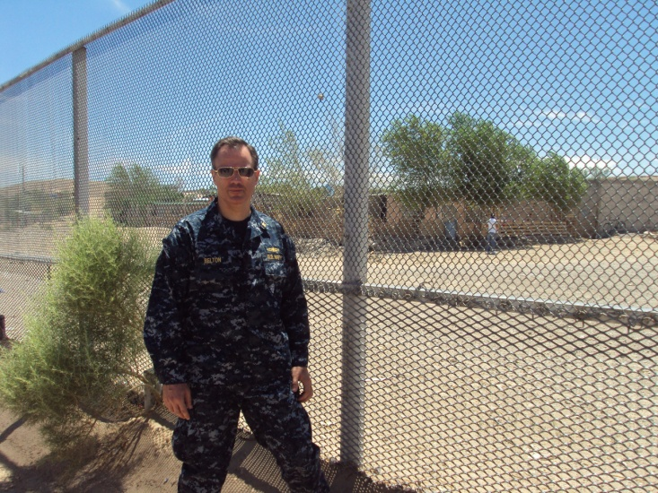
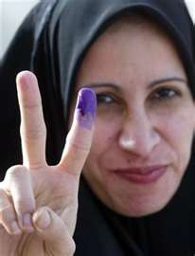
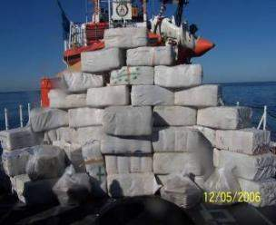

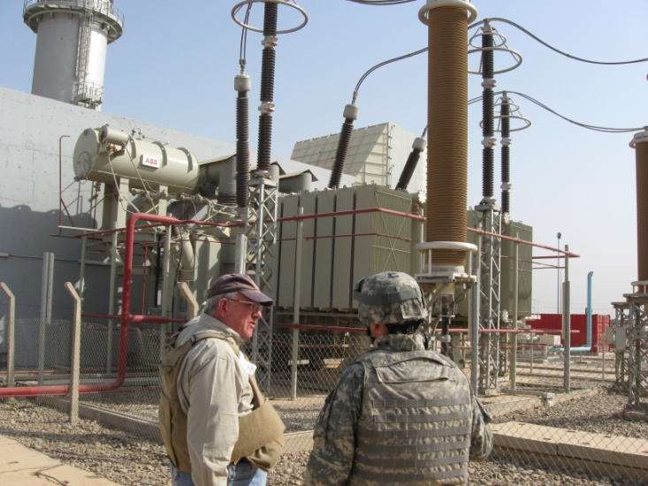
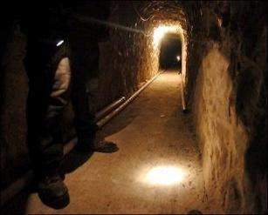
…and we think its challenging in the United States!
Making Progress in Iraq…and…
Counter Drug Operations South of the Border
Notes:
Thanks for intro
Joke…priest and e-mail
Background on trip
Examples of difficulties in consensus-building in US and Page County

Slide 2
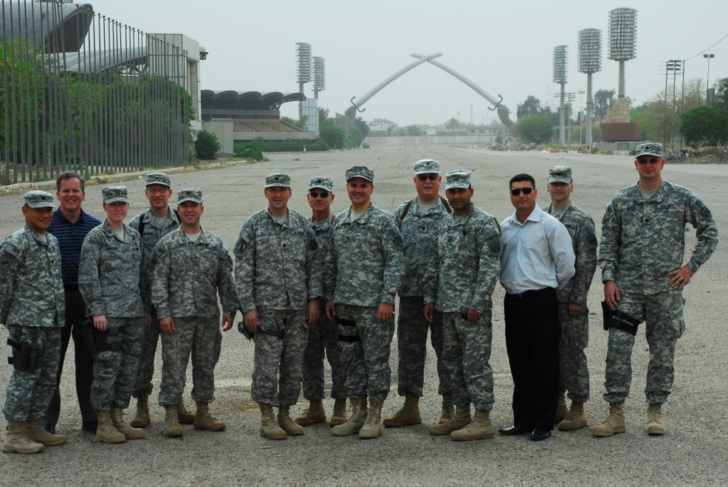
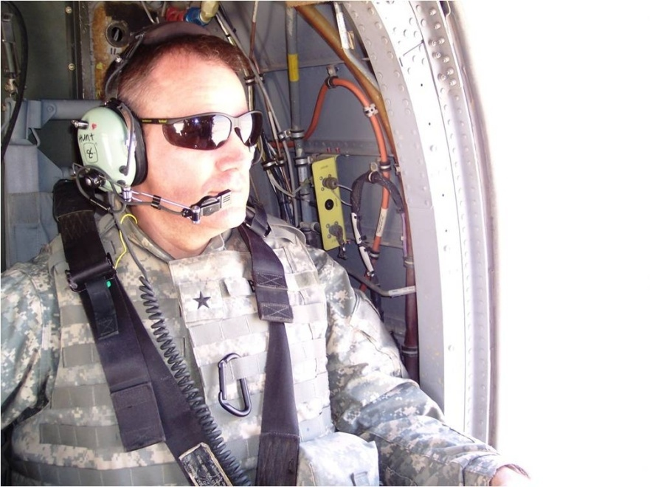
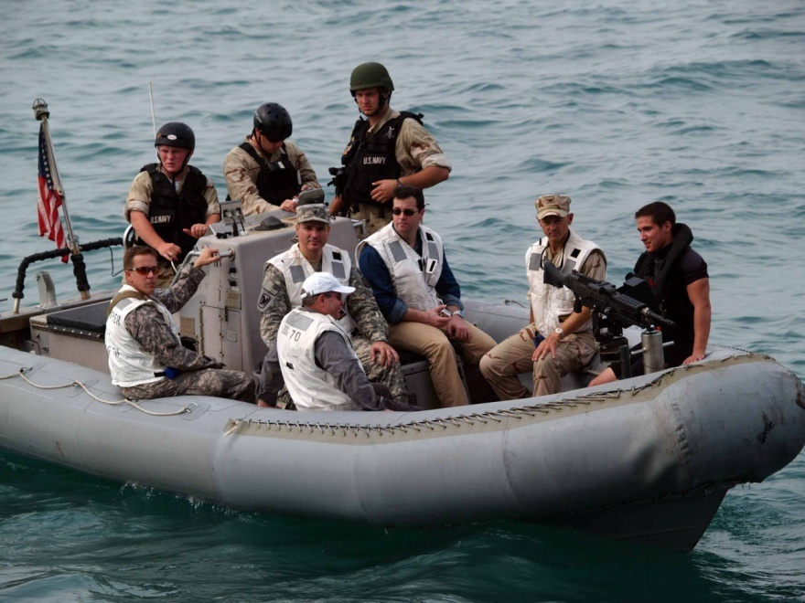
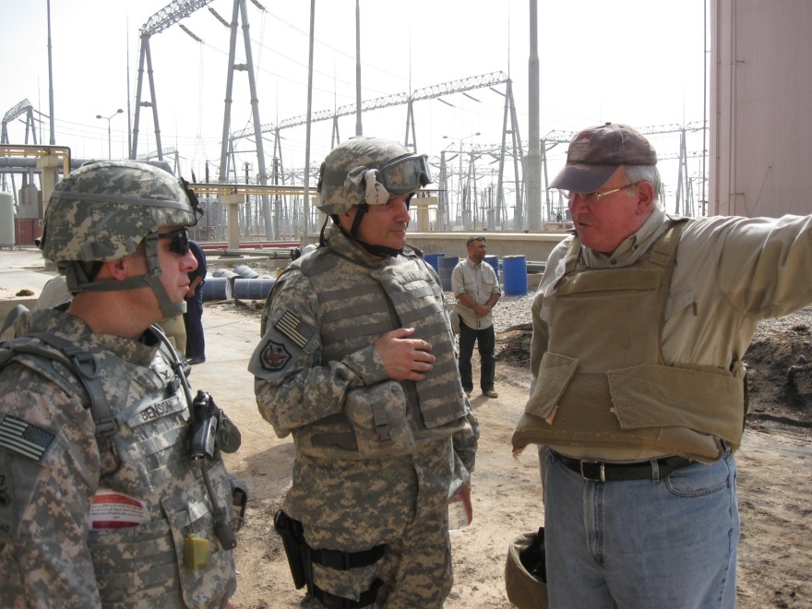
Iraqi Ministries of Oil and Electricity
Notes:
Pictures of me in Iraq

Slide 3


A Paradigm Shift
Citizens of Iraq and of the U.S. Think Differently
United States Characteristics | Iraq Characteristics
North America - Peaceful Neighbors | Middle East – Not so Neighborly
50 United States | 18 Provinces – Not All Equal
Two-Party Government System | Multi-Party Government System
Democratic Republic | Islamic, Democratic Parliamentary Republic
Diverse Market Economy | Transitioning from an Oil-dominated command economy
Predominantly Christian | Overwhelmingly Muslim
High Tech/Maintenance Culture | Low Tech/Poor Maintenance
Environmental Stewardship – Go Green | A Work In-Progress
Action Oriented | Averse to Decision-Making

Slide 4
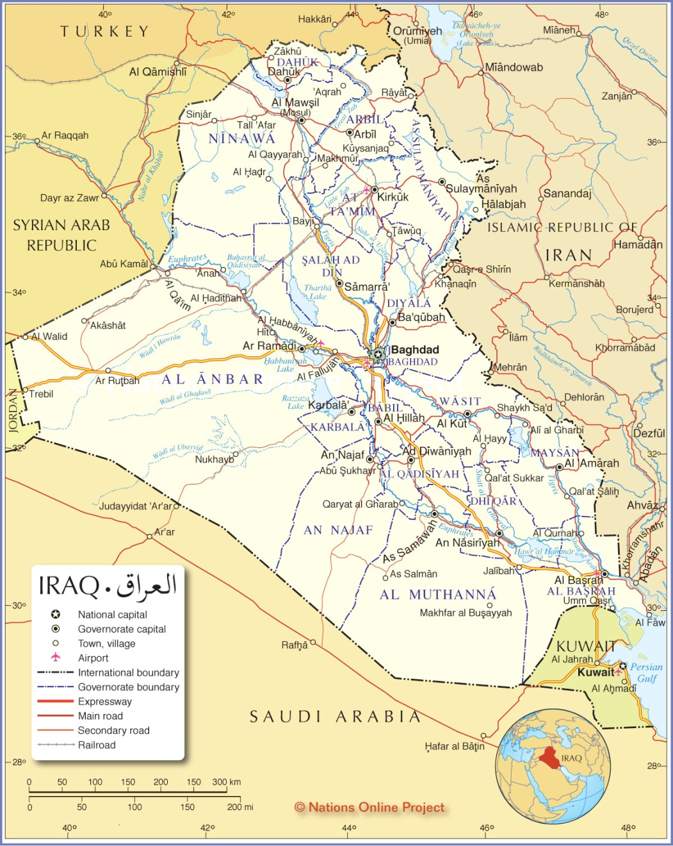
Let’s Talk About the Neighborhood

Slide 5
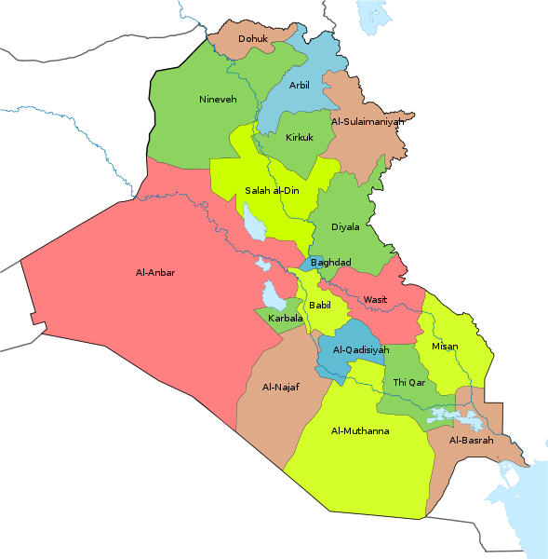
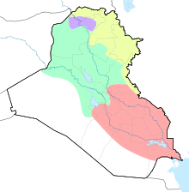
Not All Provinces Are Created Equal

Slide 6
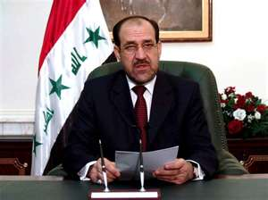
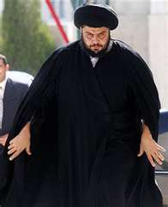
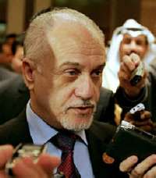
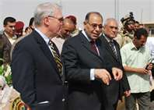
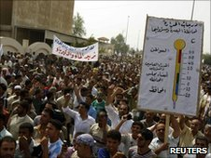
All Together Now
Parties | Vote | Ministers
Al-Iraqiya | 24.72 | 11
State of Law | 24.22 | 10
National Iraqi Alliance | 18.15 | 10
Kurdistan Alliance | 14.59 | 4
Gorran | 4.13
Unity Alliance | 2.66 | 1
Al-Tawafuq | 2.59
Kurd Minorities | 3.45 | 2

Slide 7
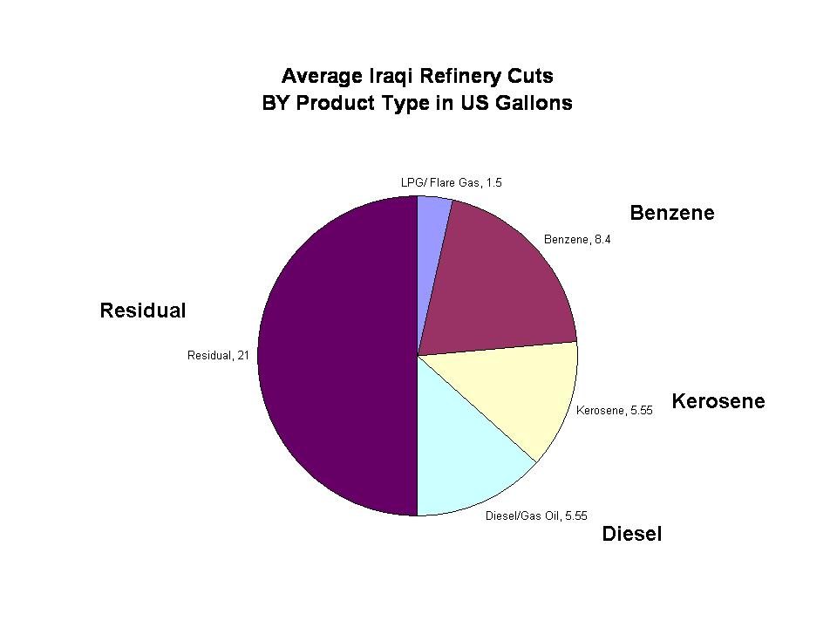
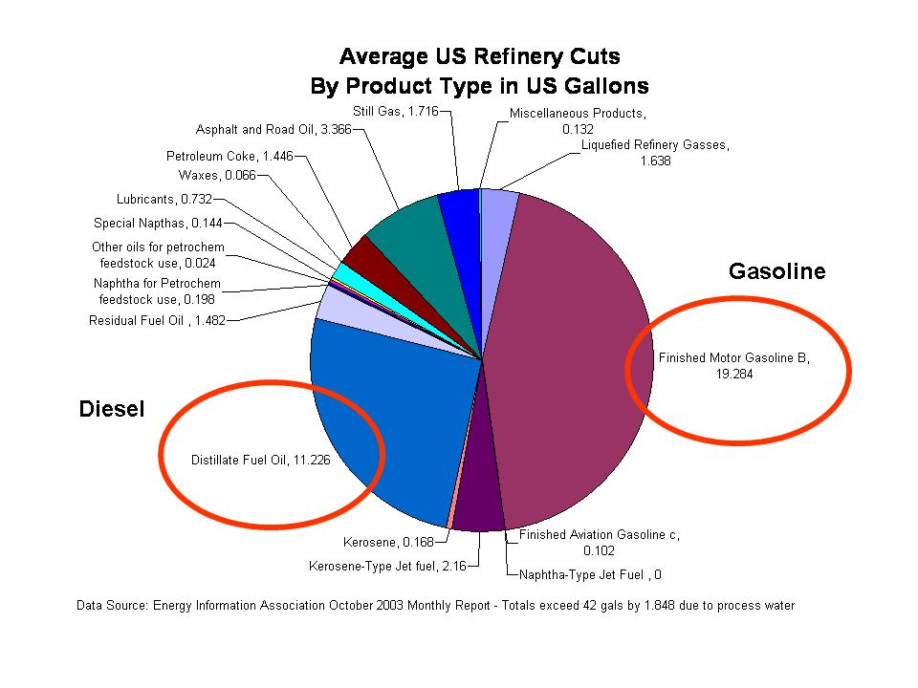
Low Tech/Maintenance Challenges – Energy Sector
Refinery Capability
Iraqi Refinery
U.S. Refinery

Slide 8
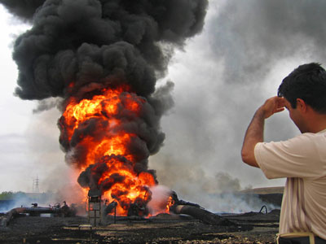
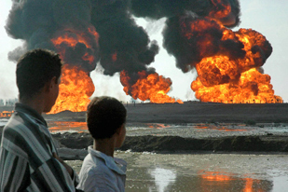
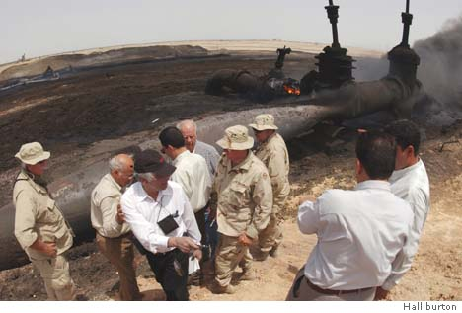
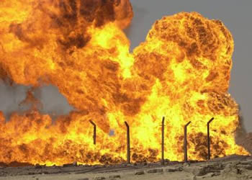
Security Challenges – Energy Sector
Pipeline Sabotage

Slide 9
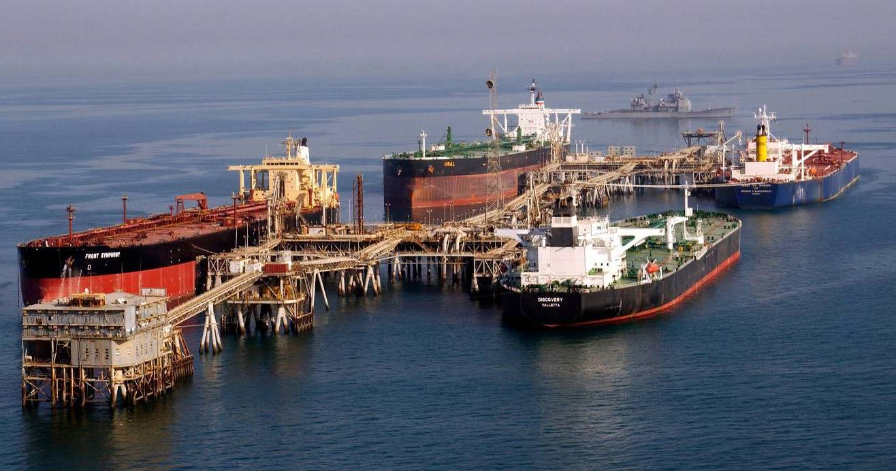
Low Tech/Maintenance Challenges – Energy Sector
Al-Basrah Oil Terminal

Slide 10
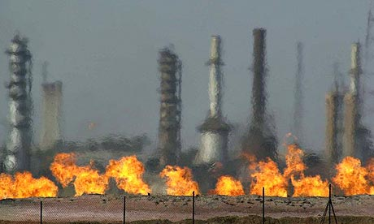
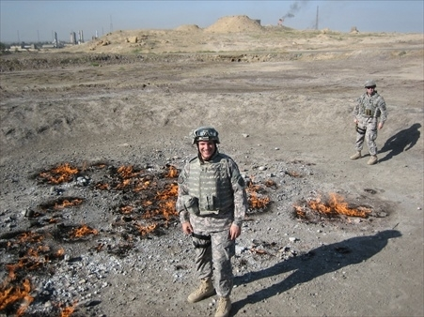
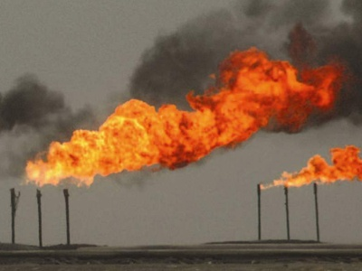
Low Tech/Maintenance Challenges – Energy Sector
Flaring Associated Gas

Slide 11
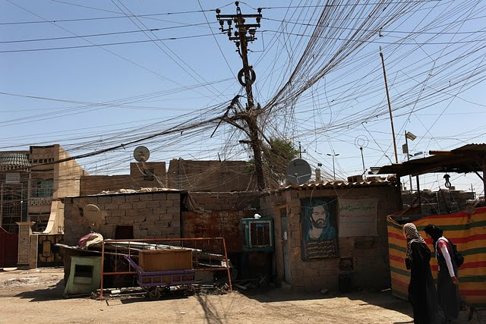
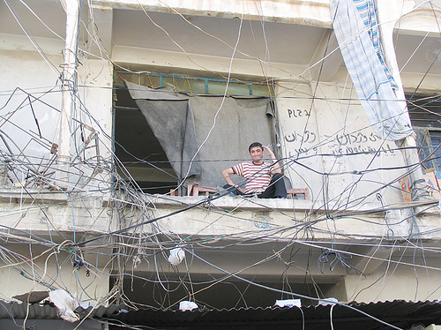
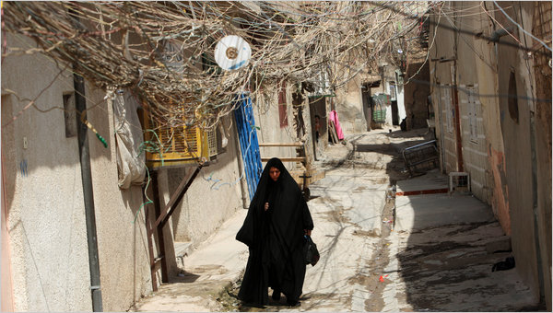
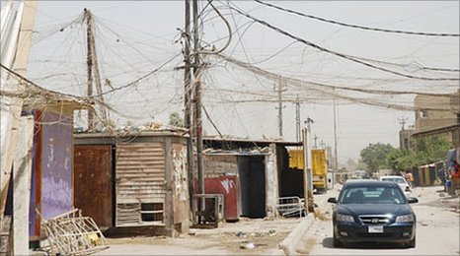
Security/Maintenance Challenges – Energy Sector
Electricity Theft and Entrepreneurship

Slide 12
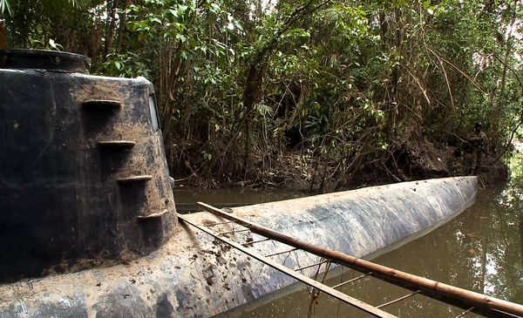
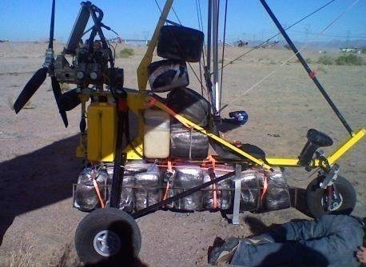
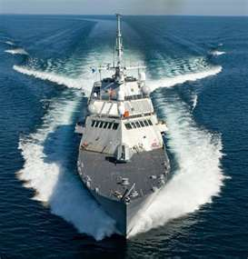
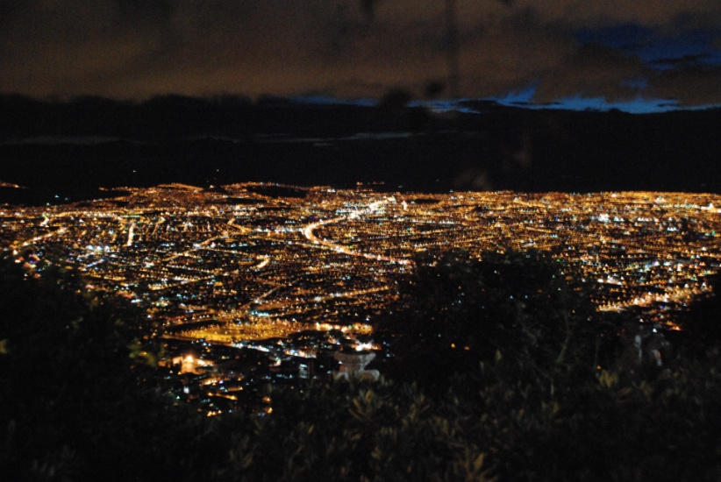
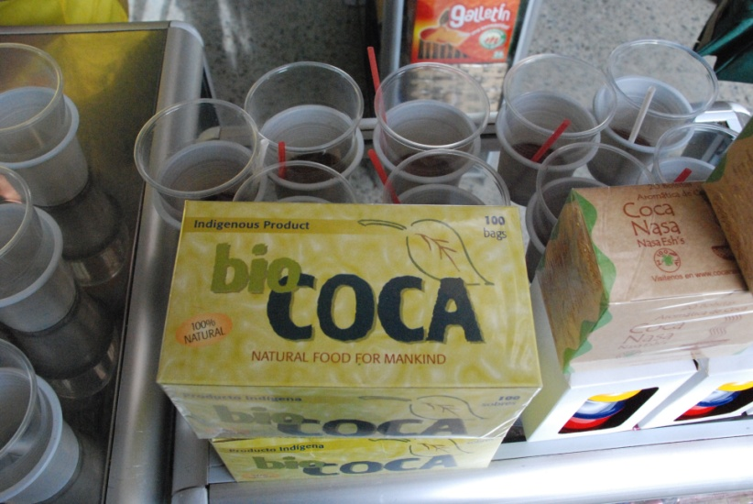
Counter Narco-Terrorism Operations

Slide 13
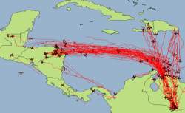






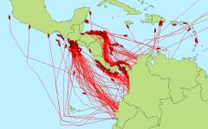
“PROBLEM SET”
> 99% of TOTAL drug and alien smuggling flows, into the US come, from US SB
< 1% of TOTAL drug flow into the US comes from US NB
(NSS/USBP)
JIATF-S Air Tracks (Jan – Jun 2010)
(NSS/USBP)
New York
NSS/USBP
ARRIVAL
Kansas City
San Diego
San Ysidro
El Paso
20% of Cocaine Flow
Nogales
Laredo
Miami
Brownsville
JIATF-S Maritime Tracks (2010)
<8%
30%
80% of Cocaine Flow
TRANSIT/SOURCE
20%
Activity Zones
50%
Strategic Chokepoint
> 90% of Cocaine from SOURCE Zone Transits Mexico
“Golden Triangle” Marijuana & Heroin Production
(IACM)
SOURCE
Notes:
This build slide shows how the criminal organizations focus. The red circles are how we discuss the problem set by source, transit and arrival zone. Success in the maritime and air environments have created the primarily land-based problem depicted here.
Drug Trafficking and Alien Smuggling Organizations (ASOs) continue to successfully move illicit cargos through the SWB and NB. To date, there are no known linkage by Foreign Terrorist Organizations (FTOs) in the Southern Threat Approaches.
JTF-North is tracking six principal cartels in the drug trade:
The Sinaloa Cartel
The Gulf Cartel
The Arellano Felix Organization/Tijuana Cartel (AFO)
The Zeta
The Vicente Carrillo Fuentes Organization/Juarez Cartel (CFO)
and the Arturo Beltran Leyva Organization (ABLO).
The Sinaloa and Gulf Cartels remain the more powerful of these organizations. We will go into
more detail on the cartels on a future slide.
The next slide will discuss the threat approaches.

Slide 14
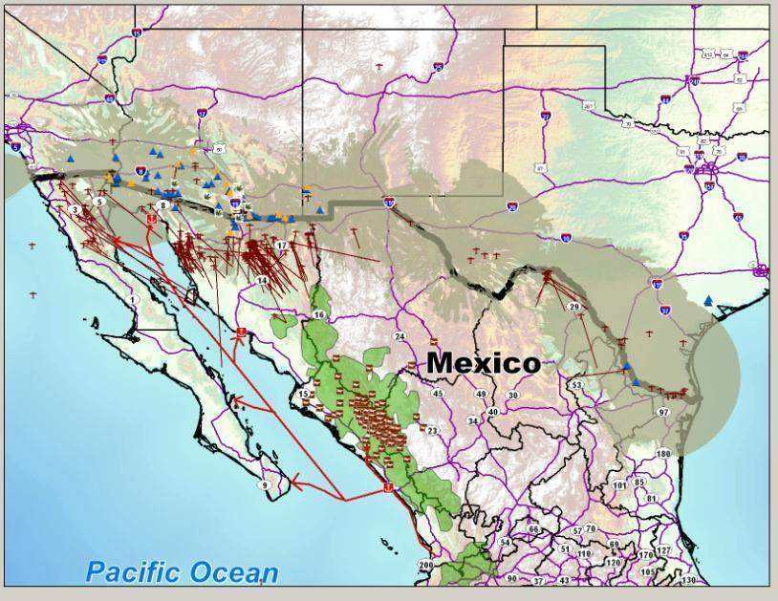
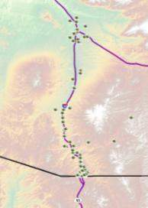
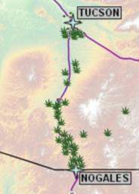

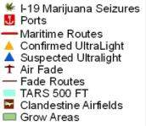

Sonora Threat Approach Activity
1. Largest foreign producer of Marijuana – 15.5K MT
2. Predominantly dirt strips 2k ft – 3k ft length, 4.5k ft 10k ft elevation
3. Approx 150 events YTD – 65% in Tucson Sector
4. Approx 44 events YTD – 52% in Tucson Sector
5. Principal MODE commercial fishing vessel
6. I-19, principal thoroughfare into Tucson distribution networks
TUCSON
PHOENIX
TUCSON
NOGALES
NOGALES

Slide 15
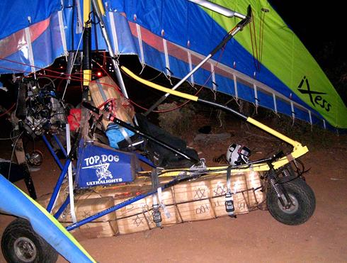
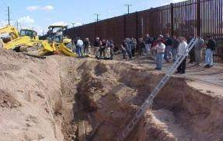
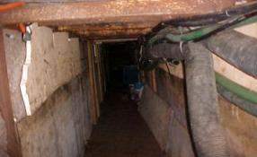
Ultra Lights and Tunnels

Slide 16

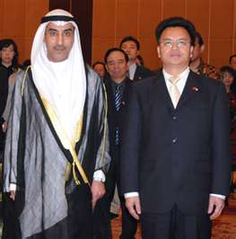
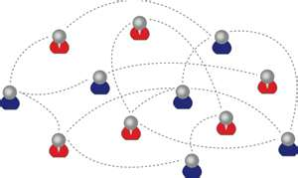

So How Does All This relate to
County Government?
Recognizing Diversity is Important
There is Tremendous Synergy in Working Together
The Importance of Relationships Can’t Be Over-Emphasized

Slide 17

Does your governing body reflect the population…with all its visible and hidden traits ?
“The Supper Club ‘clique’ runs the county”.
“I don’t know any of their names…they’re all ‘old’ people” .
“Not one citizen has called me about that issue”.
Diversity is about recognizing, valuing and leveraging the total sum of unique traits each citizen brings to the community.

Slide 18
Benefits of Cooperation in Counter-Drug Operations
22 Years of support
Developed Relationships
TTPs directly applicable to contingency ops
High Return on Investment
Operation against “thinking adversary”
Directly impacts National Security
Value to LEAs:
Value to The
Nation:
Value to DOD:
- 90% METL Correlation
- Military Unique
Capabilities
> $2 Billion in seizures
- Increased Readiness
DOD Investment of
<$10 Million / yr
- Intelligence assets and analysis
- Go To War Tasks
Deter, Prevent Transnational Criminal Organizations (TCOs)
- Real-world Mission
- Increased operational reach
- Operational
opportunity
Federal cooperation in contingency ops
- Border denial
in remote areas
- AOR similarity on SWB
Defense of the Homeland
Notes:
BENEFITS OF JTF-N MISSIONS
This slide highlights that there are obvious Benefits of JTFN missions as well as some “not so obvious” benefits.
First, is the Federal Law Enforcement agencies’ benefit from the unique capabilities that DOD brings to their mission. These include equipment and personnel like aircraft and radars as well as intelligence assets and analysis.
DoD units also benefit by executing a real world mission that tests the skills they will need in the event they are called upon in a wartime environment. They operate against an adaptive, thinking threat in an area of operations with heavy similarity to Iraq and Afghanistan and some units incorporate JTF-N missions in their train-up for contingency deployments.
Finally, there is significant value to the nation. For a relatively small investment of less than $10M a year, the nation benefits from increased seizures of drugs, increased security, and from the interagency cooperation between DoD, Federal Law Enforcement and numerous other agencies.

Slide 19
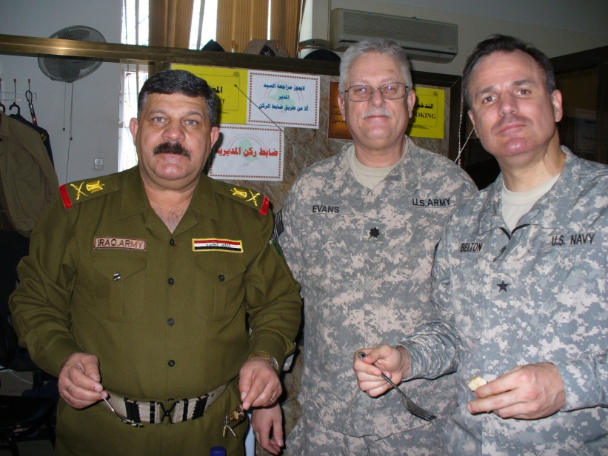
Iraq Oil Pipeline Infrastructure
Ceyhan Terminal (Turkey)
Mosul
(Hammam Al Aleel)
IT2A
Kirkuk
IT2
IT1
3
16” Product
K1
46” IT Crude
40” IT Crude
IT1A
K2
Bayji
Refinery
K3
8” LPG
8” Gas
16” Gas
2
Syria
Hadithah
1
PS4
12” Crude
BAGHDAD
Under Repair
Oil Field
Pump Station (Out of Service)
Al Amarah
Liquid Petroleum Gas
Natural Gas
Product Line
PS3
PS2
PS1
48” Crude
Crude Line
42” Strategic
Crude Line
Long term out of Service
Basrah Refinery
Rumayla
ABOT and KAAOT oil platforms

Slide 20
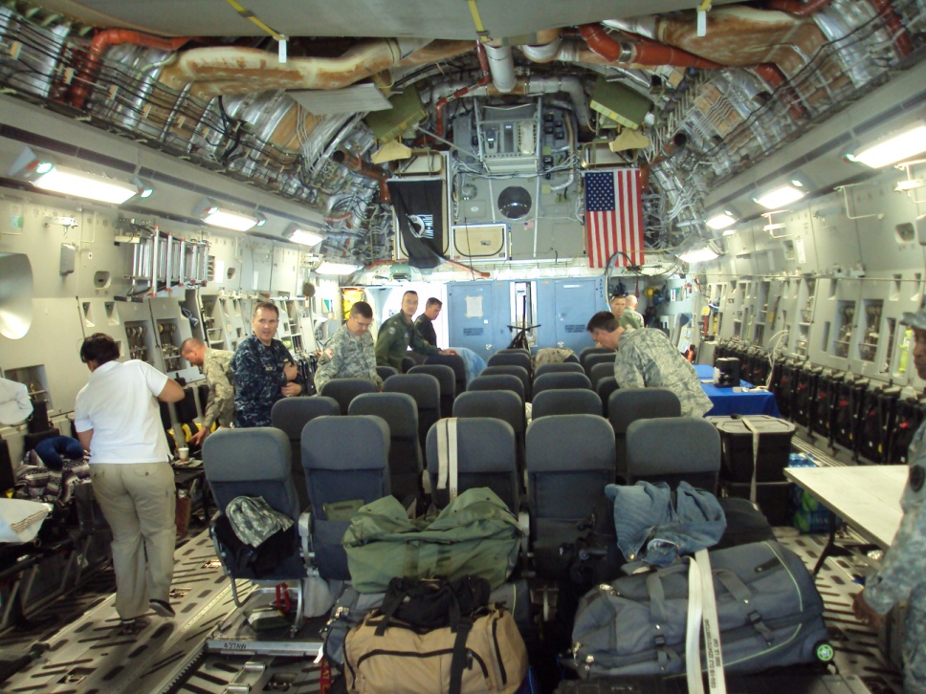
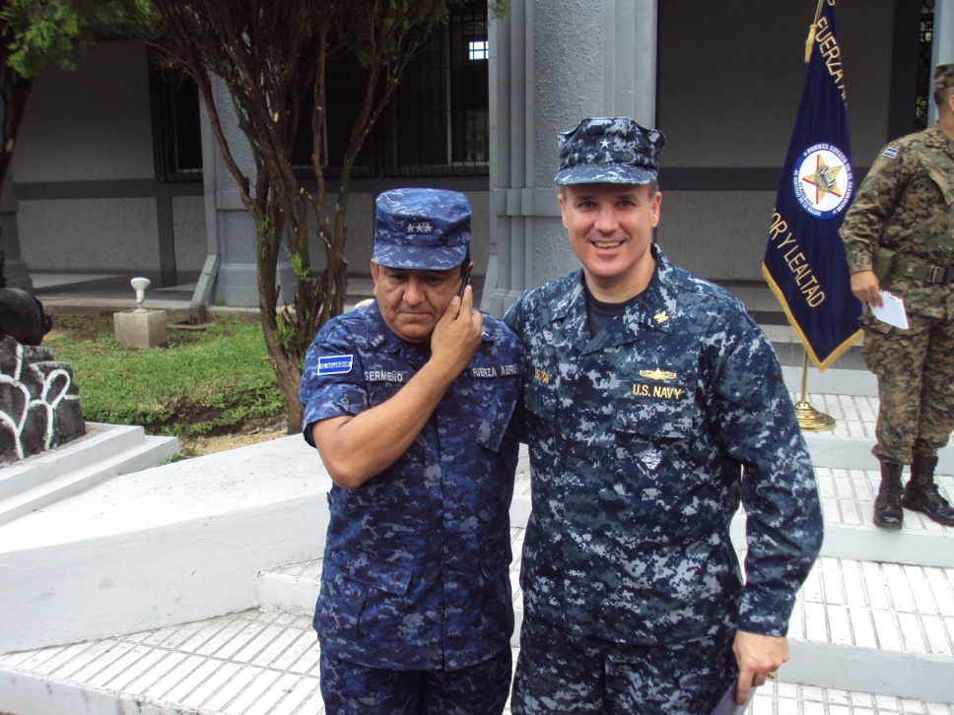


Questions?

Slide 21
Back-Up

Slide 22





JCP Condition | Improved Essential Services and Infrastructure
JCP Objective | Influence energy sector to provide fuel
Key Task | Increase hydrocarbon energy production
ESD Oil Snapshot

Slide 23

Concrete Efforts
Without 2nd Bid Round
In Execution
Approaching Execution
KRG efforts
~$1-2B investment
~75K bbl/day
Need KRG-GoI agreement to restore exports/increase production capacity.
Ahdab Field Contract w/CNPC
$2-3B investment
25K bbls/day w/in 3 yrs; 115K bbls/day w/in 6 yrs.
Service Contract executed Nov 2008.
1st Bid Round Win – Rumaila w/BP/CNPC
~$20B investment
1.85M bbls/day increase w/in 6 years
11/03/09: Contract signed
1st Bid Round Revisited--Negotiating
Zubair (ENI/OXY/KOGAS)
  ~$10-20B investment
  900K bbls/day increase w/in 6 years
  Agreed to contract; @ CoM for approval
West Qurna-1 (XOM/Shell)
  ~$30-50B investment
  1.2-1.8M bbls/day increase w/in 6 years
  Agreed to contract; @ CoM for approval
Nassiriyah Field EPC Contract w/Nippon
~$8B investment in Engineering, Procurement, and Construction (EPC) contract
Includes a 300 Kbpd refinery
Up to 300K bbls/day in 2-3 yrs
Finalizing contract
Impact of Efforts on Oil Production
(circles’ areas are proportional to production increases)
KRG
Ahdab (CNPC)
West Qurna 1
Nasiriyah (Nippon)
Zubair (ENI)
Rumaila (BP/CNPC)

Slide 24
GOI Ability to Contribute
Potential for increased revenues
Assumes SERP is delivered on schedule
4.4
New Oil Revenue
14.5
Nassiriyah
Zubair
Potential Financing Gaps
2.2
17.5
West Qurna
7.6
Rumaila
8.8
30.6
2012-13 Revenue projections assume GOI receives $80/bbl
16.8
Budgeted/Projected
Revenue
Actual Revenue
Budgeted/Projected
Expenditures
Actual Expenditures
Cash Reserve/Deficit
Loans & Grants
Financing Gap
South Export Redundancy Project (SERP)
Three 48” off-shore pipelines
Four single-point moorings
Extensive upgrades to pump
stations & storage
Phase 1: ABOT Redundancy for 1.8 MBD
Phase 2: Capacity Increase to 3 MBD
Phase 3: Capacity Increase to 4.5 MBD

Slide 25
JCP Condition | Improved Essential Services and Infrastructure
JCP Objective | Improved supply and delivery of electricity
Key Task | Increase electricity production
Electricity Supply
Recent generation online:
1243 MW YTD
  Quds GT (90 MW)
51 MW generation planned next 30 days:
Baghdad South GT (51 MW)
Projected system improvements (>30 days):
Chamchamal GT (100MW)
Samarra Diesel (51 MW) (3 x 17 MW generators)
Kartet Power Ships (250 MW)
Kirkuk – Erbil – Mosul 400kV Line
Hyundai Diesel Project (120 MW)
Weekly Average
135,156 MWH
Current Weekly Average
4,521 MW

Slide 26

Feasible Capacity vs. Demand
Data represents best case estimates for capacity. Data does not account for:
Delayed construction
Lack of funding
Fuel or water shortages
Changes in weather
“Inshallah”
100% capacity
85% capacity
70% capacity
55% capacity
Current Capacity
12,382 MW
Difference in trend lines are mathematical only and do not represent an estimate of real losses.
Notes:
Feasible capacity is calculated by degrading ISO capacity by factors to account for unit and fuel type, and an “Iraq” factor. The above curves represent future capacity at 1.0, .85, .70 & .55 Iraq factor.
Demand is from recent Parsons-Brinkerhoff load forecasting study, and represents unsuppressed peak load, with no reserve, and 95% diversity factor.
Station report data from 7 November indicated 5571 average MW against 11,280MW feasible capacity.

