Slide 1
Tourism IS
Economic Development!
Presented by Judy Hare Winslow
Director of Tourism,
Smithfield & Isle of Wight Convention & Visitors Bureau

Slide 2
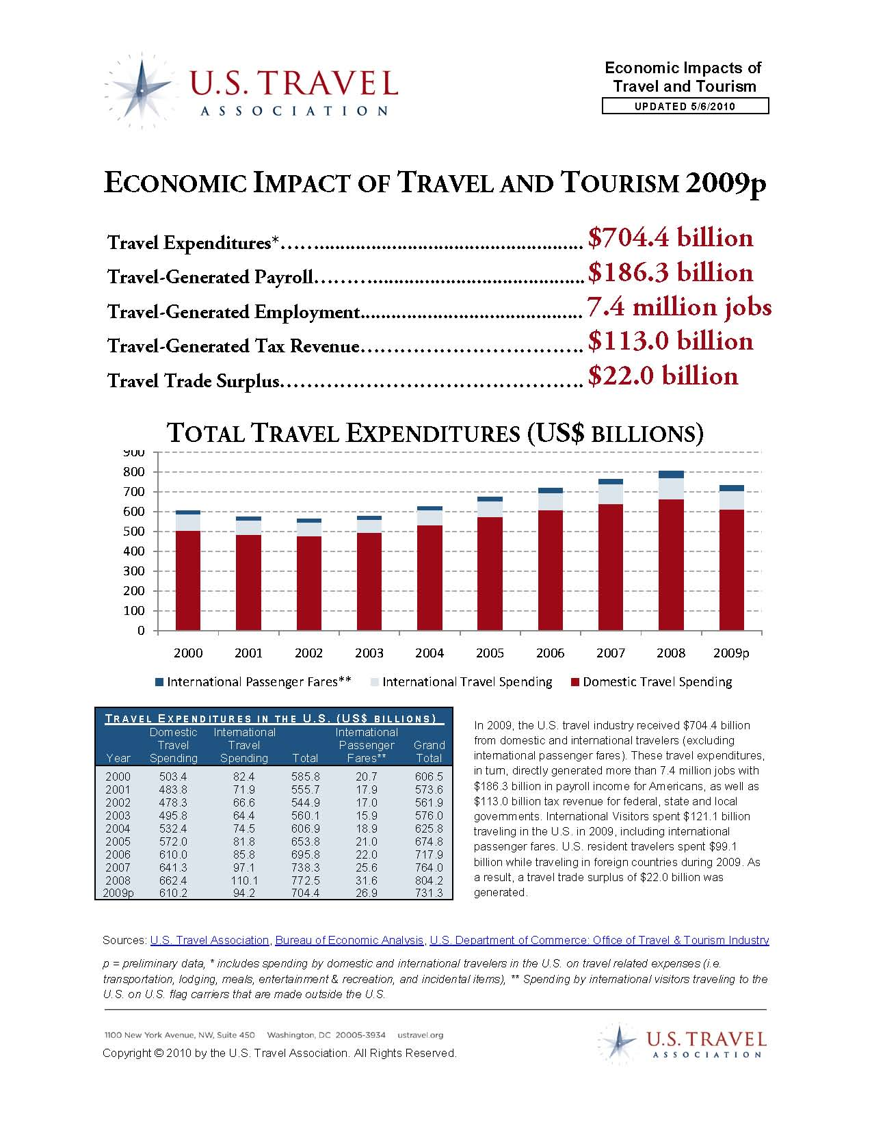

Slide 4
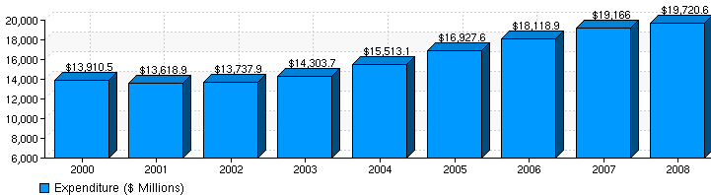
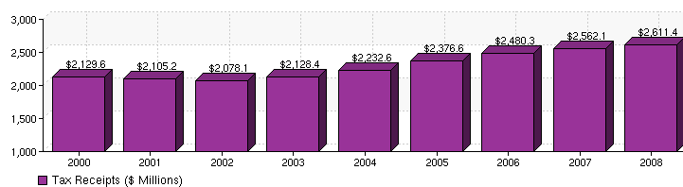
Travel Powers Virginia
(Includes both domestic and international travel impact)
Virginia: Travel Spending ($ Millions)
Virginia: Travel Tax Receipts ($ Millions)

Slide 5
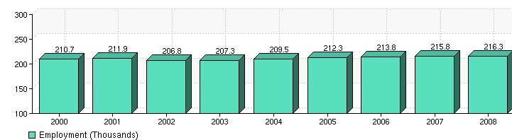
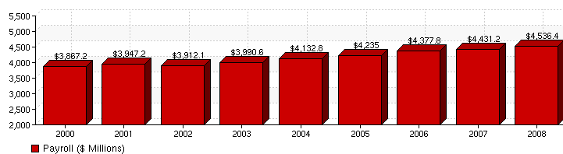
Travel Powers Virginia
(Includes both domestic and international travel impact)
Virginia: Travel Employment (Thousands)
Virginia: Travel Payroll ($ Millions)

Slide 6


Slide 7
Tourism =
NEW MONEY!

Slide 8
Something to see
and/or experience
Somewhere to eat
Somewhere to stay
Something to buy

Slide 9
The whole COMMUNITY must be
developed as a tourist attraction.
Understanding the MARKET and its potential
is critical to TOURISM development.
The most likely PROSPECTS for enterprise development are at the LOCAL LEVEL.
ENTREPRENEURS become true prospects
when INVESTORS &DEVELOPERS are added.

Slide 10
First time entrepreneurs and those opening
new markets are high-risk PROSPECTS.
NETWORKING with business suppliers and
allies outside the community is smart.
NOT-FOR-PROFIT enterprises or attractions
can be prospects just like any other.
PUBLIC/PRIVATE PARTNERSHIPS put
communities into PROSPECT DEVELOPMENT.

Slide 11
Successful marketing campaigns build upon themselves year after year. An investment in your tourism marketing arm with dedicated funding is an investment in your own future- Remember the ROI!
Make sure you have a Chief Marketing Officer
to achieve the greatest results and align dollars to support individual marketing initiatives.
“Brand” everything you do consistently.

Slide 12
Develop a local
Tourism Development Grant program.
To create the complete tourism experience,
maximize visitation and average length of stays,
product development is essential!
Support new tax law legislation to “fix” the On-line Travel Companies siphoning of state and local taxes.
DO NOT Support the OTC’s Federal preemption legislation that would prevent taxing authorities’ ability to collect taxes from these companies

Slide 13
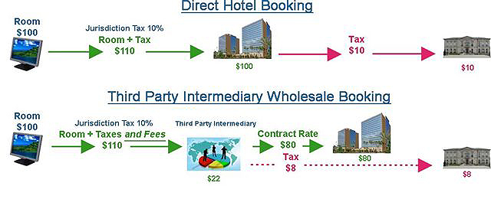
Direct Hotel Booking
Third Party Intermediary
Wholesale Booking

Slide 14
Tourism IS
Economic
Development!

Slide 15
Tourism is
BIG BUSINESS…
& Small Business!

Slide 16
Tourism creates an immediate & proven
RETURN ON
INVESTMENT

Slide 17
Tourism can play a leading role in
Economic Recovery more quickly than any other industry.

Slide 18
Tourism =
NEW MONEY!
Tourism product development is setting up and getting ready to ring a cash register with new dollars brought into a community by visitors.

Slide 19
In order to be successful in the tourism “business” you must provide visitors:
Something to see and/or experience
Somewhere to eat
Somewhere to stay
Something to buy

Slide 20
Key Recommendations
Find your tourism niche and have a dedicated staff person or department
Dedicated Funding for Tourism
Develop a Tourism Grant Program
Be aware of the OTC tax issue and participate in preserving YOUR tax revenue!

Slide 21

Tourism IS
Economic Development!
Presented by Judy Hare Winslow
Director of Tourism,
Smithfield & Isle of Wight Convention & Visitors Bureau

