Slide 1
Bioenergy Research:
Biological Systems Engineering, Virginia Tech
Jactone Arogo Ogejo
arogo@vt.edu
(540) 231 6815
Presented at:
VACo’s 2010 Annual Conference
November 8, 2010

Slide 2

Bioenergy research in Biological System Engineering department is based on the concept of a biorefinery.
Energy crops
Forest and wood products
Agric. crop residues
Manures
Municipal wastes
Food wastes
Biomass
Source
Logistics
Biomass Processing
Pyrolysis
Synthetic Biology
Metabolic Engineering
Anaerobic Digestion
Algal Conversion
Nutrients
Waste
Products
Biofuels
ethanol
bio-oils
biodiesel
hydrogen
electricity
methane
Renewable biomaterials

Slide 3
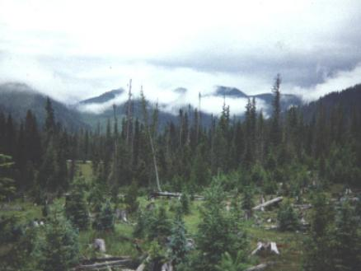
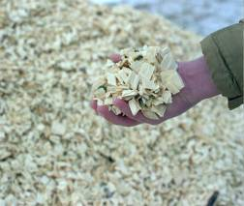
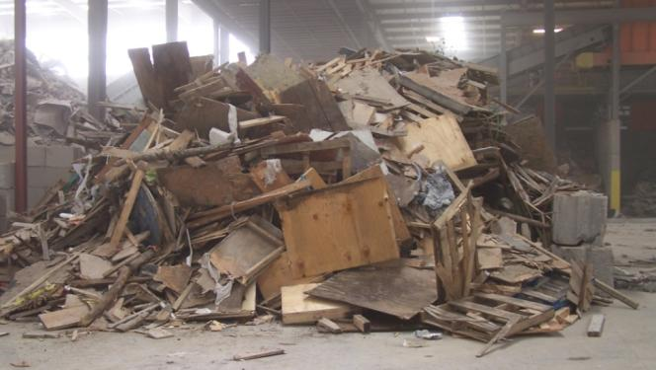
Examples of biomass for bioenergy production in Virginia
Forest and wood residues
Thinning residues
Wood chips
Urban wood waste (pallets, crate discards, wood yard trimmings)

Slide 4
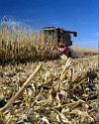
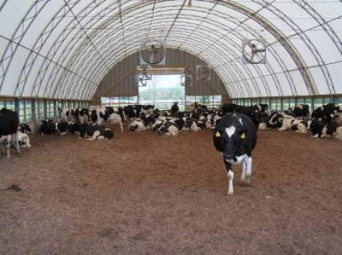
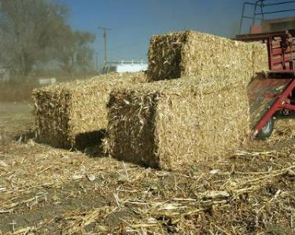
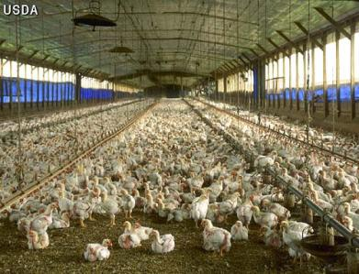
Examples of biomass for bioenergy production in Virginia
Agricultural residues
Animal manure
  Dairy
  Beef
  Horse
  Swine
Poultry
  Broilers
  Turkeys
Crop residues
  Barley
  Corn
  Oats
  Sorghum
  Wheat

Slide 5
Examples of biomass for bioenergy production in Virginia
Food waste
Poultry processing plants
Preprocessing and retail food waste
  Institutions e.g. schools dining halls, restaurants, hospitals
  Grocery stores
Post consumer
  Institutions

Slide 6
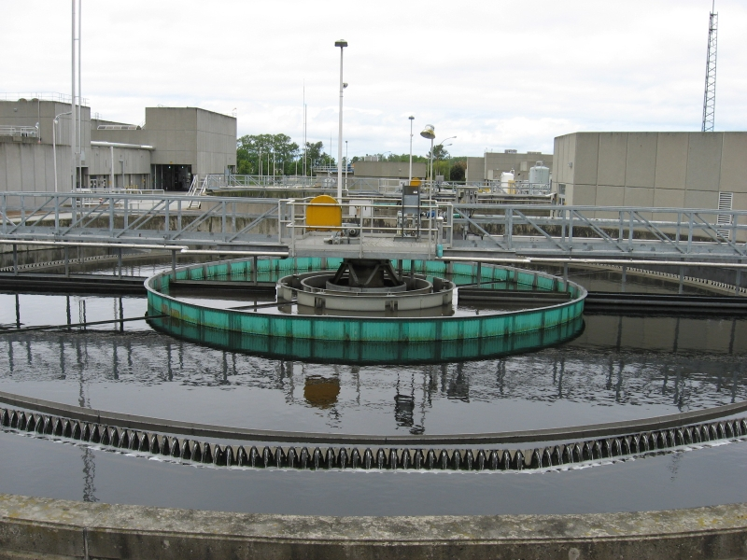
Examples of biomass for bioenergy production in Virginia
Municipal waste
Municipal wastewater
Garbage - households

Slide 7
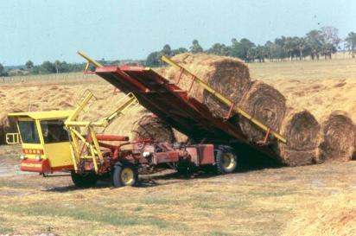
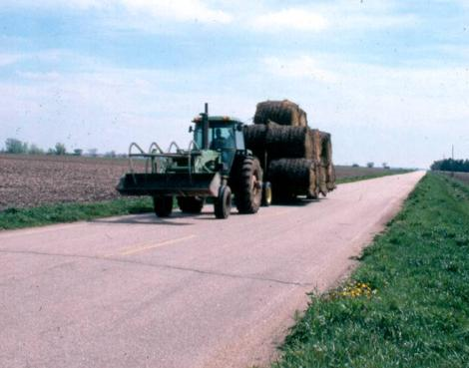
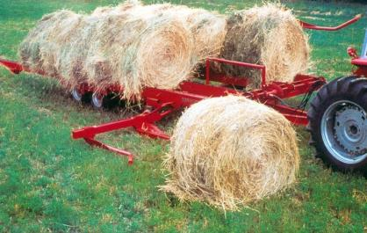
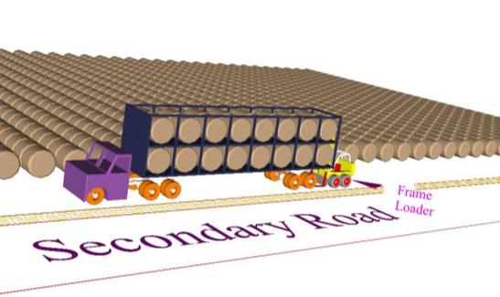
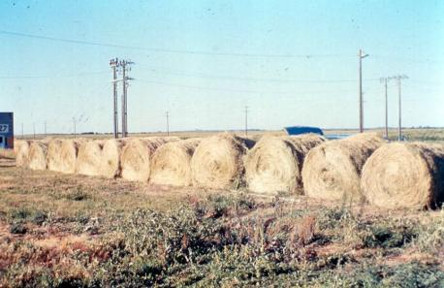
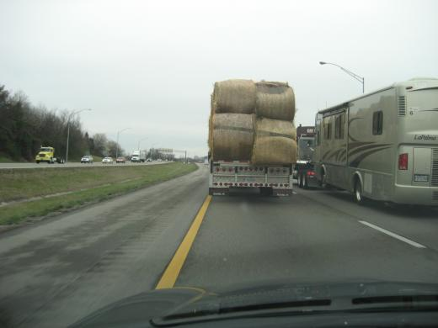
The biomass needs to be collected and transported to the biorefinery processing center. Our research includes:
In-field hauling efficiency
Distances to gather material
Satellite storage locations
Hauling to biorefinery processing center
Drs. Cundiff and Grisso

Slide 8
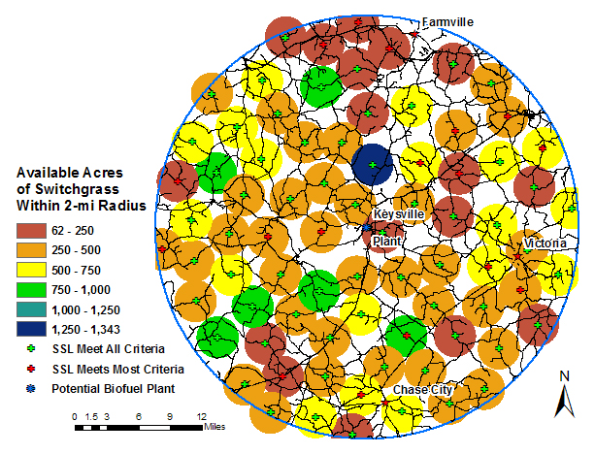
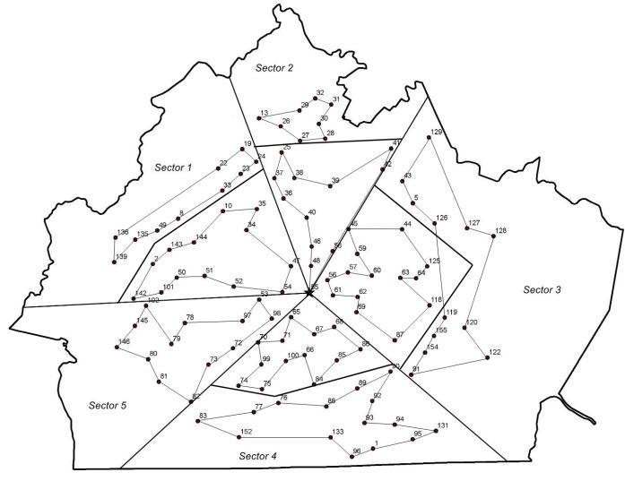
Production of biomass and location of biorefinery needs planning
Potential production
Logistics of unloading storage
Drs. Cundiff and Grisso

Slide 9

The biorefinery processes include:
Pyrolysis
Synthetic Biology
Metabolic Engineering
Anaerobic Digestion
Algal Conversion

Slide 10

Pyrolysis (Dr. Agblevor)
Thermal conversion of organic materials in the absence of oxidizing agents such as oxygen
Always occurs before any combustion process
Leads to thermochemical decomposition of organic materials into a complex mixture of compounds
Feedstock
(Biomass)
Drying and size reduction
Reactor
Cooling, Separation
Char
Liquid
Gases

Slide 11
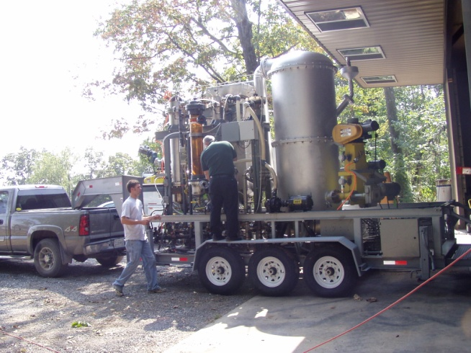
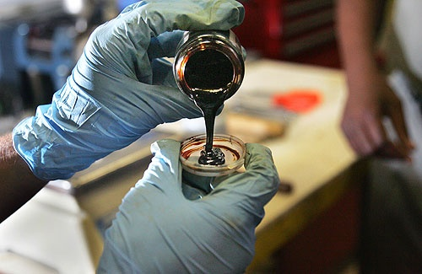
Dr. Agblevor has designed and built two pyrolysis units.
First is a transportable unit being used in the Shenandoah Valley to demonstrate the with poultry litter as feedstock
Sample of bio-oil produced from pyrolysis of poultry litter

Slide 12
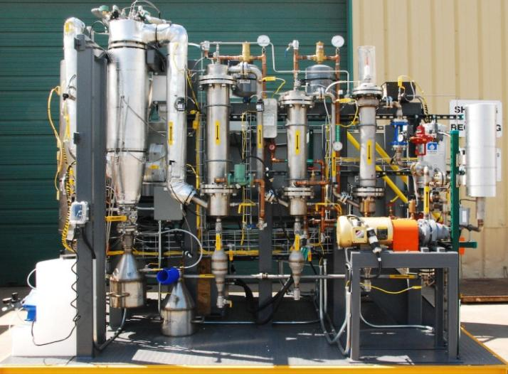
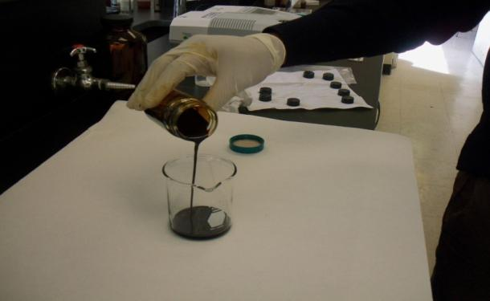
Second is a 4.4 lbs/h unit which uses wood powder (sawdust) to produce bio-oil
Sample of bio-oil produced from wood powder

Slide 13
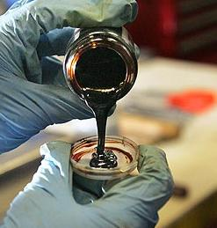
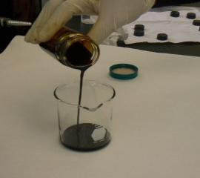
The bio-oil can then be further processed or used to produce other value added products or energy
Gasoline
Ethanol, mixed alcohols
Lubes
Kerosine/Diesel
LPG
Waxes
Hydrogen
Oxochemicals e.g. ketones
Ammonia

Slide 14
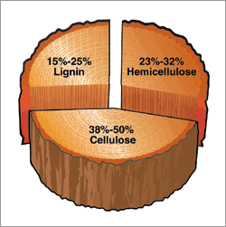
Overview of Dr. Zhang (Biofuels) Lab – Synthetic Biology
Consolidated bioprocessing
Cellulase
engineering
2nd biofuels
Reactive amorphous cellulose
Ethanol
COSLIF
CH
Soluble sugars
C_{n}H_{m}
Microdiesel
Non-food biomass
Cell-free SyPaB
3rd biofuels
Hydrogen
~$0.18/kg sugar
> 90% yield
Electricity
Sugar release
Sugar conversion

Slide 15
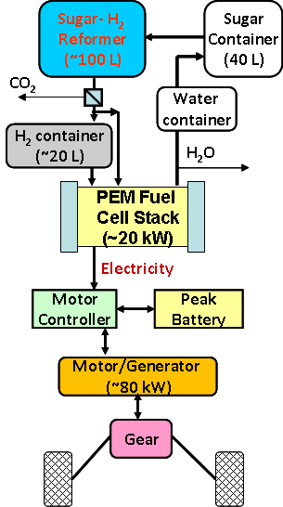
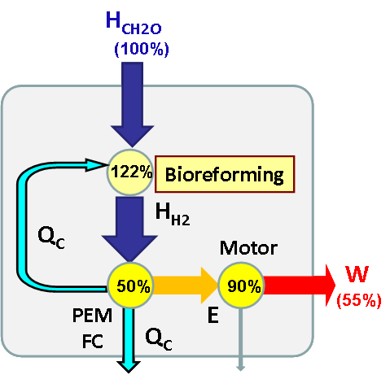
Future sugar fuel cell vehicle (SFCV)
Most efficient power train system
SFCV has similar or higher BTK than BEV; much higher than ICE and HICE.
Zhang. Energy Environ. Sci 2009:2:272
Zhang. Nature Precedings. 2009, 3725.1

Slide 16

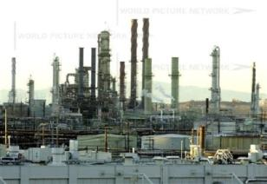
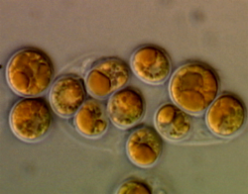
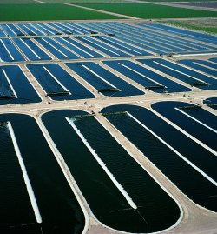
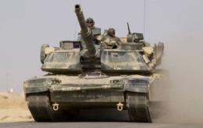

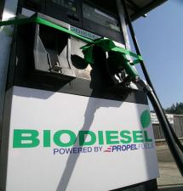
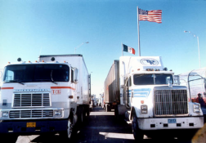
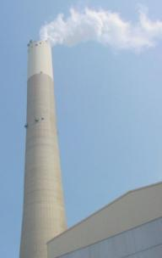
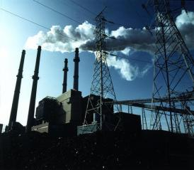
Growing microalgae for biofuel production- Dr. Wen
Petroleum Refinery or Biodiesel plant
Microalgae
60%
Triglyceride
CO₂
Jet Fuel (JP-8)
40%
Carbohydrates
and
Protein
Cultivation Ponds
Ethanol
Power
Food
Green Diesel
Biodiesel

Slide 17
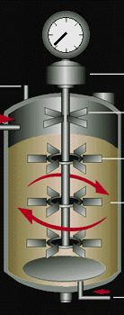
The Consolidated Bioprocess (CBP) - Dr. Senger
Single-stage fermentation: Cellulose ➔ Biofuels
Considerations of the CBP
Production of all saccharolytic enzymes
Digestion of cellulosic biopolymers into fermentable sugars
Fermentation of all hexose sugars (e.g., D-glucose)
Fermentation of all pentose sugars (e.g., xylose)
Pre-treated
cellulosic feedstock
Biofuels
Problem: No organisms exist in nature that can perform all of these functions and grow at a rate that can result in an economically viable bioprocess
Solution: We will metabolically engineer organisms to do it!

Slide 18

Biogas from Biomass - Ogejo
Biomass: manure, food and industrial processing wastes
Focus
How to maximize biogas production
  Substrate combination?
  Appropriate digestion technology?
Appropriate digestion model
Conservation and recovery of nutrients
Development of educational materials
Training the trainer
Single Substrate
Co-Digestion
On-Farm or On-Site
Co-operative
Central or Community
Utilization
Generate electricity; Provide heat; Supply piped gas; Transportation fuel; Fertilizer

Slide 19


Biogas from Biomass
OUTPUTS
Feedstock
FERTILIZER
90% less odor
Reduce P & K (separation)
N – form bioavailable to plants
On-farm use and/or sold
Water Quality (e.g. reduction in pathogens, leaching of N)
Manure (dairy, swine)
TECHNOLOGY
DIGESTER
ORGANIC FOOD WASTE
BEDDING
Locally Made
ELECTRICITY REVENUES
GENERATOR
Farm Power
Power to Grid
REC & Carbon Credits
Other Credits
Tipping Fees
ENVIRONMENT
90% less odor
P and K reduced
Adjusted N - better form, then reduced

Slide 20
Biogas options for Virginia Dairies
Capital Cost of Anaerobic Digestion Systems
Very little being done for dairies with < 500 cows
Of 432 dairies in Virginia, only 3 are > 500 cows (average = 110)
Large population of Mennonite farmers, many use diesel generators for farm’s electricity needs
Is there an opportunity here?
What about nutrient management issues?
?
Fuel Cost Comparison
SOURCES:
AgSTAR Anaerobic Digestion Capital Costs for Dairy Farms - Feb. 2009
An Analysis of Energy Production Costs from Anaerobic Digestion Systems
on U.S. Livestock Production Facilities NRCS, 2007

Slide 21

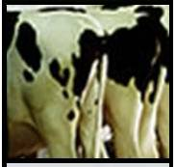
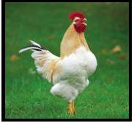


Biogas Options for Virginia Dairies
Combine the high volume, homogeneous poultry processing waste streams with manure from surrounding dairies to generate more biogas per unit volume of digester
Determine the optimum mix of organic materials to produce maximum quality and quantity of gas

Slide 22
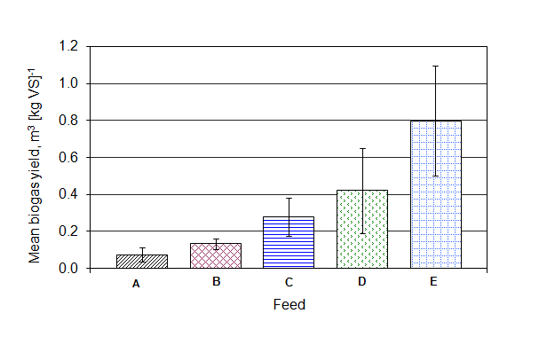
Gas Production and Quality
Biogas yield increased as PPW ratio increased
Feed | Methane Content (%)
A (100% DM) | 55
B (67% DM) | 66
C (50% DM) | 66
D (33% DM) | 68
E (100% PPW) | 70

Slide 23
Next steps - ongoing
Determine the appropriate mix of PPW and dairy manure that gives maximum quality and quantity of biogas
Determine the economics and feasibility of installing an anaerobic digester on a small size dairy

Slide 24
Summary
How do these technologies apply to counties or communities in Virginia?
Identify the biomass type available in your locality
Match the biomass to the appropriate technology to extract energy

Slide 25
Thank You

